Slide 1

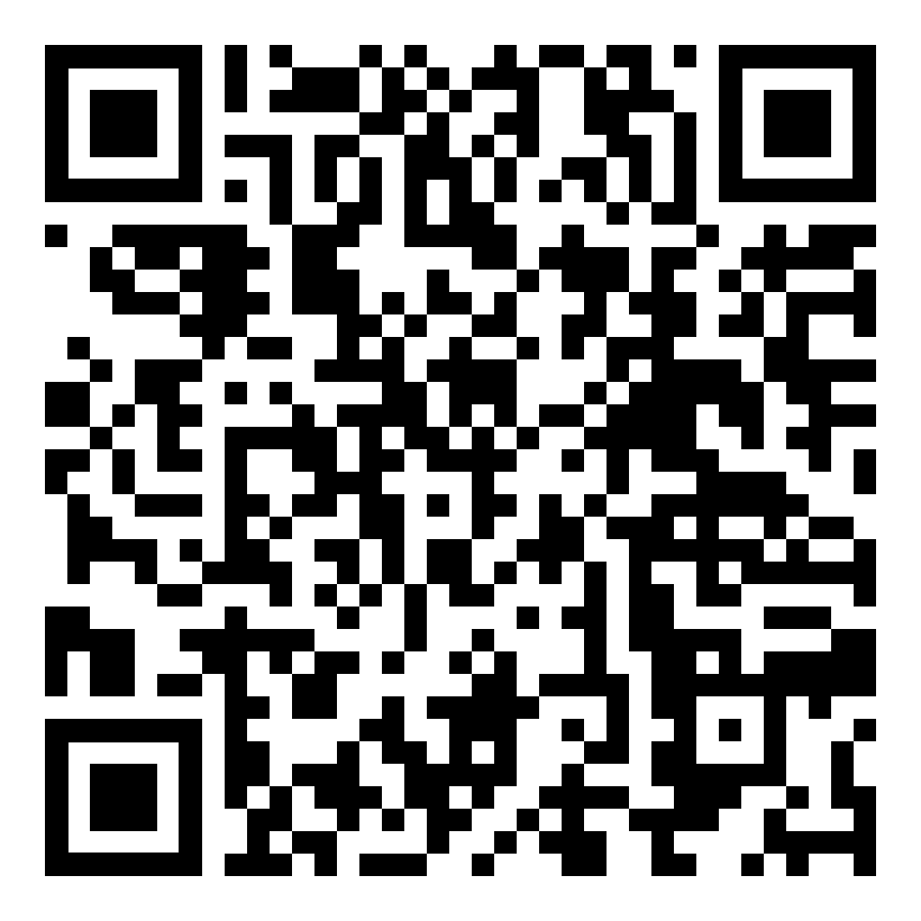

Implementing Domain-Driven Design as a pragmatic .NET developer
Download the Presentation
Halil İbrahim Kalkan
Co-founder, Volosoft

Slide 2

Writing «SIMPLE» Code
«Playing football is very simple, but playing simple football is the hardest thing there is!»
Johan Cruyff
«Writing code is very simple, but writing simple code is the hardest thing there is!»
Halil İbrahim Kalkan

Slide 3
What is Simple Code?
Easy to read & understand
Easy to maintain
Follows the same principles & coding style everywhere
You know where to find when you look for something
Doesn’t contain duplications of business logic
A use case doesn’t affect others – A change in one use case doesn’t break others
SOLID Principles – of course ☺

Slide 4
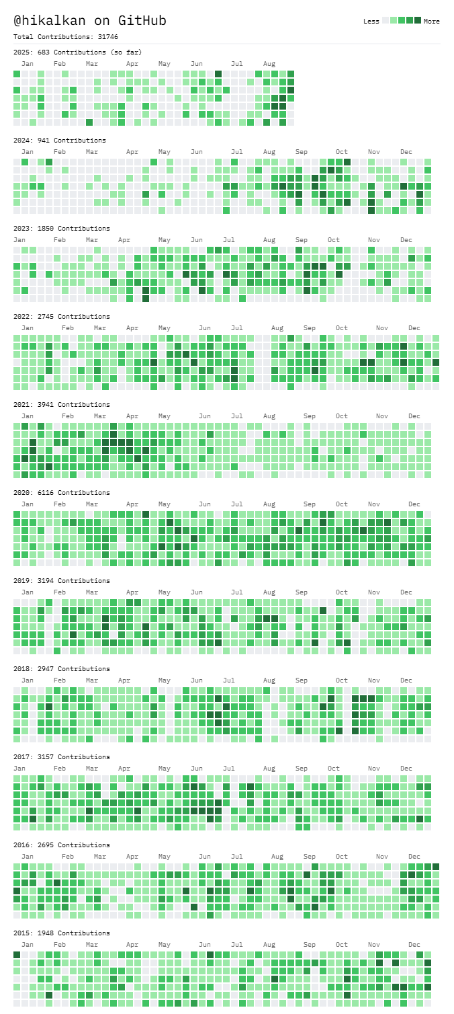







About Me: Halil İbrahim Kalkan
1997, Started programming (at 14 years old, with Turbo Pascal)
2003-2007, Computer Engineering
2007 - 2015: Software developer, software architect, team leader
2013 - ∞: Lead developer of the open source ABP Framework
2016 - ∞: Co-founder, software architect
Multi-threading, distributed/microservice systems, OOP, DDD, software architectures.. etc.
Still active coder, open-source contributor
30,000+ total contributions on GitHub

Slide 5
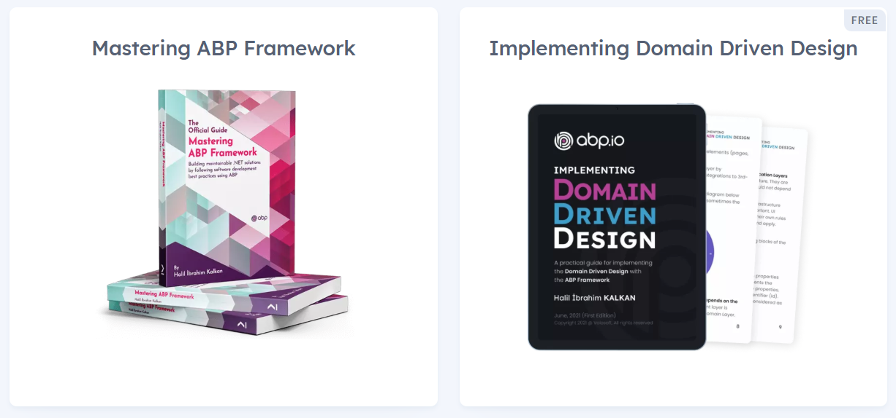
Halil İbrahim Kalkan: My Books

Slide 6
Agenda
Part-I: What is DDD?
Architecture & layers
Execution flow
Building blocks
Common principles
Part-II: Implementing DDD
Layering a Visual Studio solution
Rules & Best Practices
Examples

Slide 7
Part-I: What is DDD?

Slide 8
What is DDD?
Domain-driven design (DDD) is an approach to software development for complex needs by connecting the implementation to an evolving model
Focuses on the core domain logic rather than the infrastructure.
Suitable for complex domains and large-scale applications.
Helps to build a flexible, modular and maintainable code base, based on the Object-Oriented Programming principles.

Slide 9
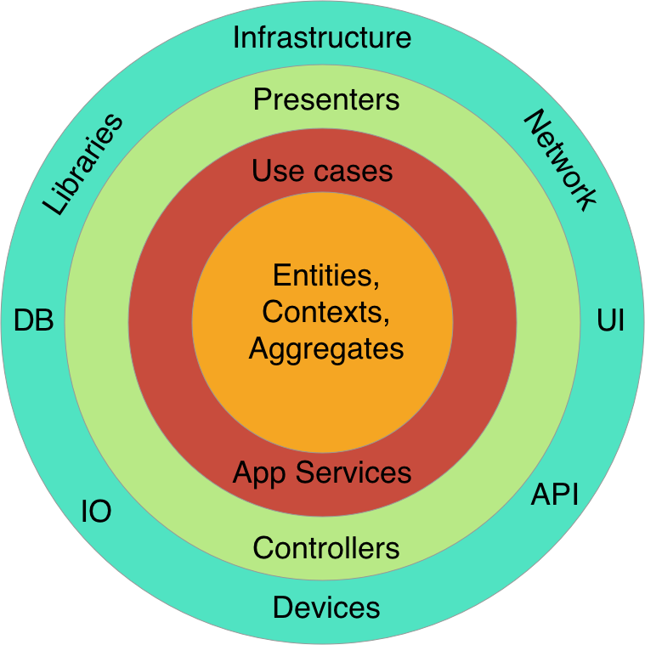
Domain Driven Design Layers & Clean Architecture
Infrastructure
Layer
Presentation Layer
Application Layer
Domain Layer

Slide 10
Domain Driven Design Core Building Blocks
Domain Layer
Entity
Value Object
Aggregate & Aggregate Root
Repository
Domain Service
Specification
…
Application Layer
Application Service
Data Transfer Object (DTO)
Unit of Work
…

Slide 11
Domain Driven Design Layering in Visual Studio
Domain.Shared
IssueConsts
IssueType (enum)
Domain
Issue
IssueManager
IIssueRepository
Application.Contracts
IIssueAppService
IssueDto, IssueCreationDto
Application
IssueAppService (implementation)
Infrastructure / EntityFrameworkCore
EfCoreIssueRepository
MyDbContext
Web
IssueController
IssueViewModel
Issues.cshtml
Issues.js
Application Layer
Domain Layer
Infrastructure Layer
Presentation Layer
Test Projects

Slide 12
Domain Driven Design Layering in Visual Studio
Infrastructure / EntityFrameworkCore
Domain
Domain.Shared
Application
App.Contracts
Web

Slide 13

Domain Driven Design The Execution Flow
PRESENTATION layer
APPLICATION layer
DOMAIN layer
HTTP request
Entities
Browsers
MVC UI
DTO
HTML/JSON/js/css
Application
Services
Domain Services
HTTP request
Remote clients
HTTP API
DTO
Repositories (interface)
JSON
Distributed Services
Layer
Authorization
Validation
Exception Handling
Audit Logging
Caching
Authorization
Validation
Audit Logging
Unit of Work / DB Transaction
C R O S S C U T T I N G C O N C E R N S

Slide 14
Domain Driven Design Common Principles
Database / ORM independence
Presentation technology agnostic
Doesn’t care about reporting / mass querying
Focuses on state changes of domain objects

Slide 15
Part-II: Implementation

Slide 16
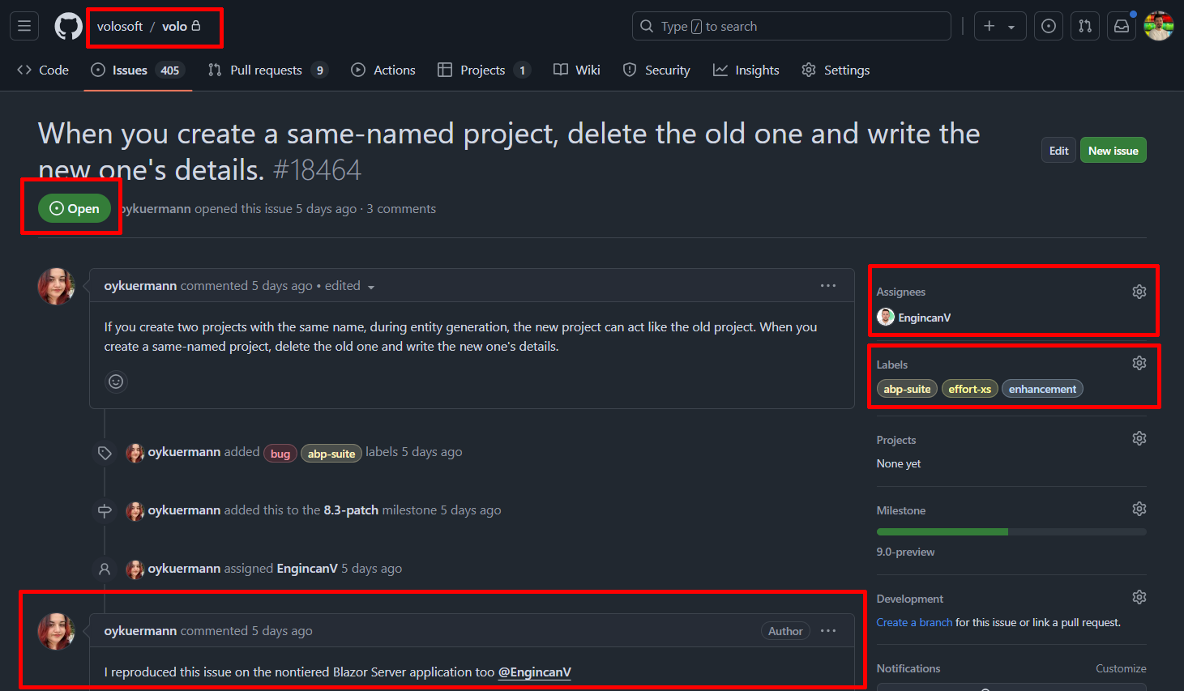

Slide 17
Aggregates Example
Label Aggregate
Issue Aggregate
Label (agg. root)
Issue (aggregate root)
Comment (entity)
Guid Id
--------------------------------------
string Name
string Color
…
Repository (agg. root)
Guid Id
--------------------------------------
string Text
bool IsClosed
Enum CloseReason
--------------------------------------
Guid RepositoryId
Guid AssignedUserId
--------------------------------------
ICollection<Comment>
ICollection<IssueLabel>
Guid Id
--------------------------------------
string Text
DateTime CreationTime
--------------------------------------
Guid IssueId
Guid UserId
Guid Id
--------------------------------------
string Name
…
…
User (agg. root)
IssueLabel (value obj)
Guid Id
--------------------------------------
string UserName
string Password
…
Guid IssueId
Guid LabelId
Repository
Aggregate
Other (entity)
Guid Id
--------------------------------------
…
…
User Aggregate

Slide 18
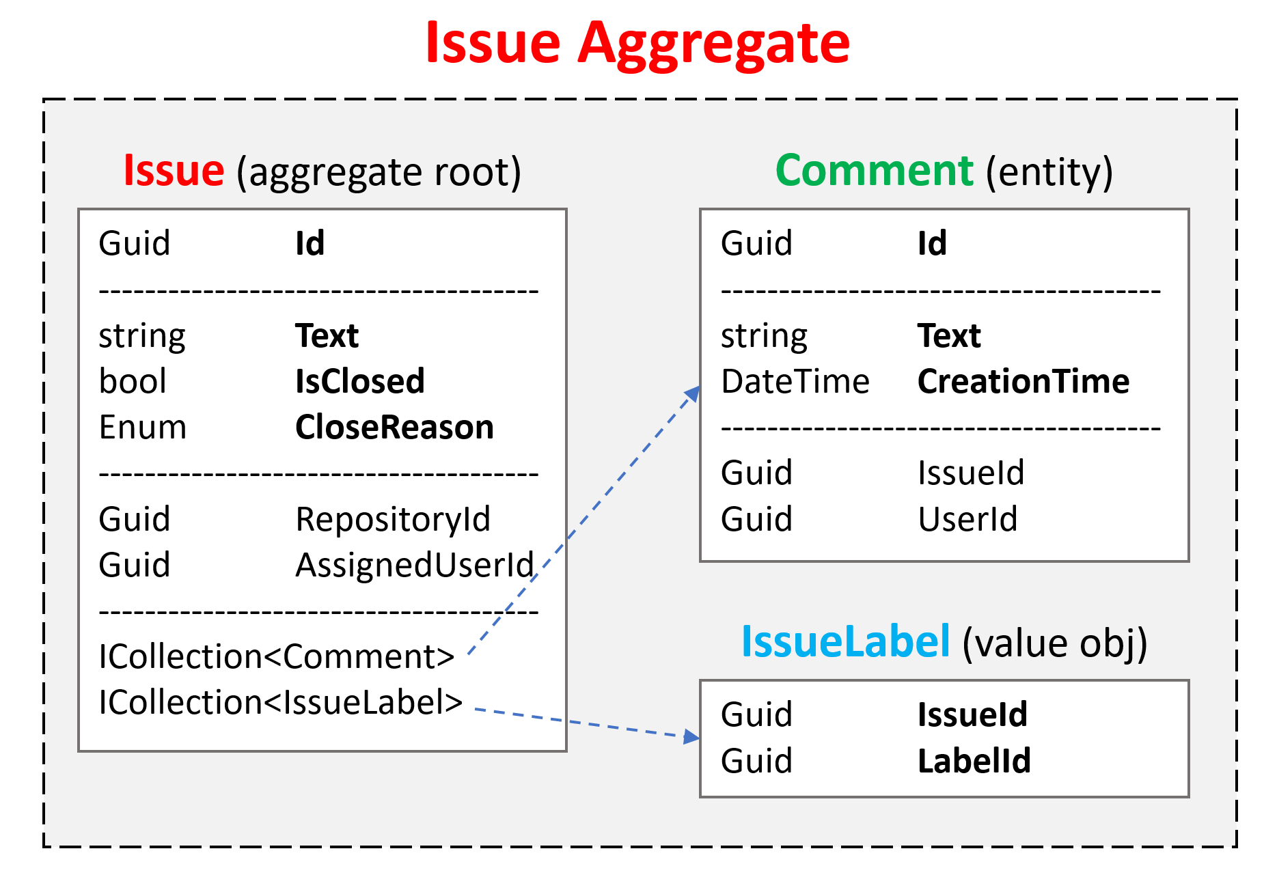
Aggregate Roots Principles
Saved & retrieved as a single unit (with all sub-collections & all properties)
Should maintain self integrity & validity by implementing domain rules & constraints
Responsible to manage sub entities/objects
An aggregate is generally considered as a transaction boundary.
Should be serializable (already required for NoSQL databases)

Slide 19
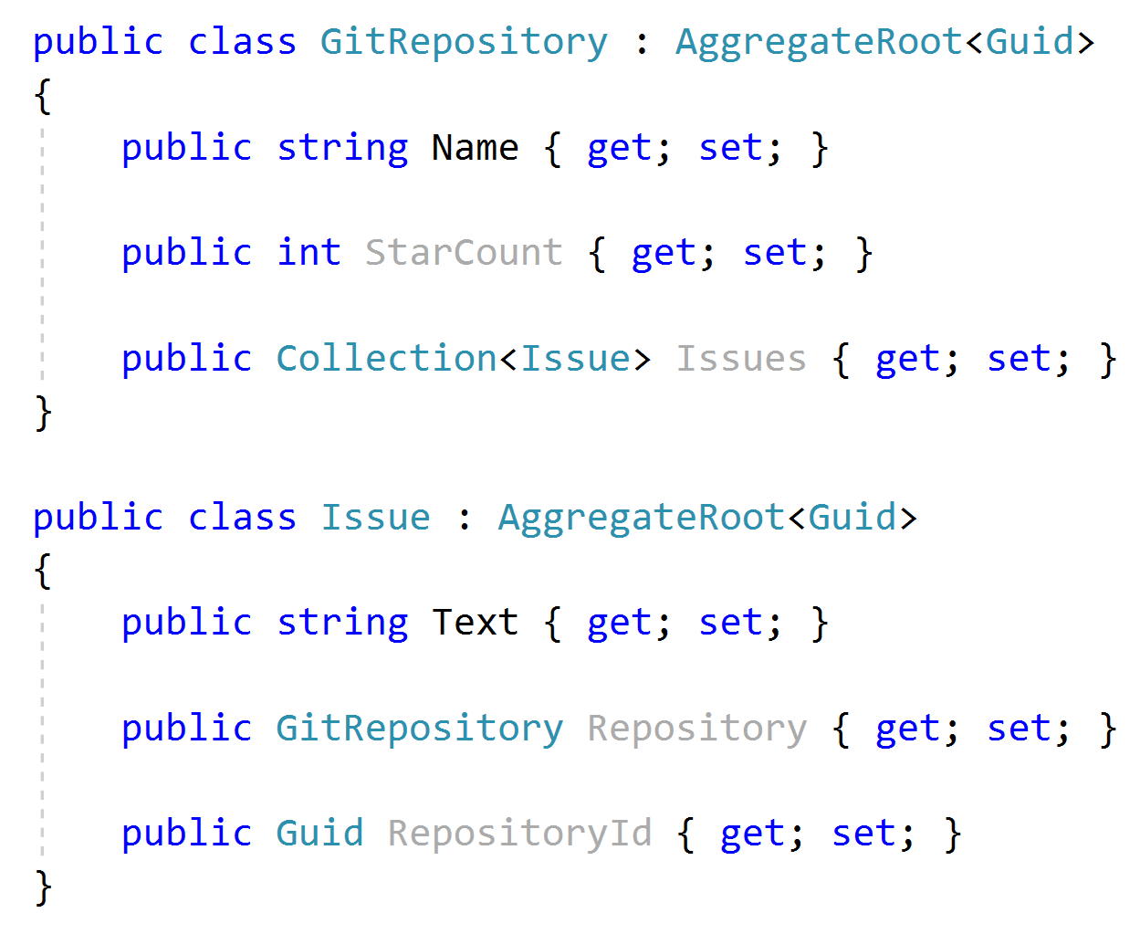


Aggregate Roots Rule: Reference Other Aggregates only by Id
Don’t define collections to other aggregates!
Don’t define navigation property to other aggregates!
Reference to other aggregate roots by Id.

Slide 20
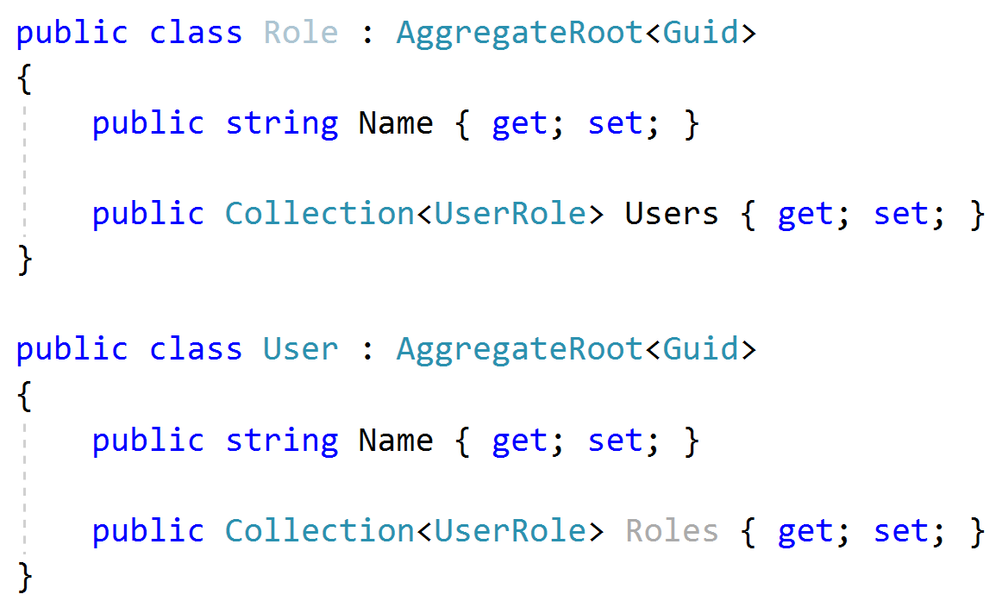
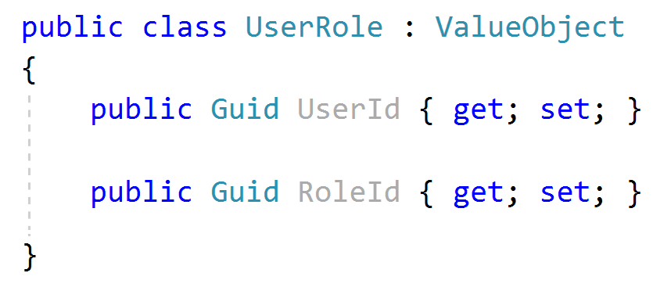
Aggregate Roots Tip: Keep it small
Considerations
Objects used together
Query Performance
Data Integrity & Validity

Slide 21
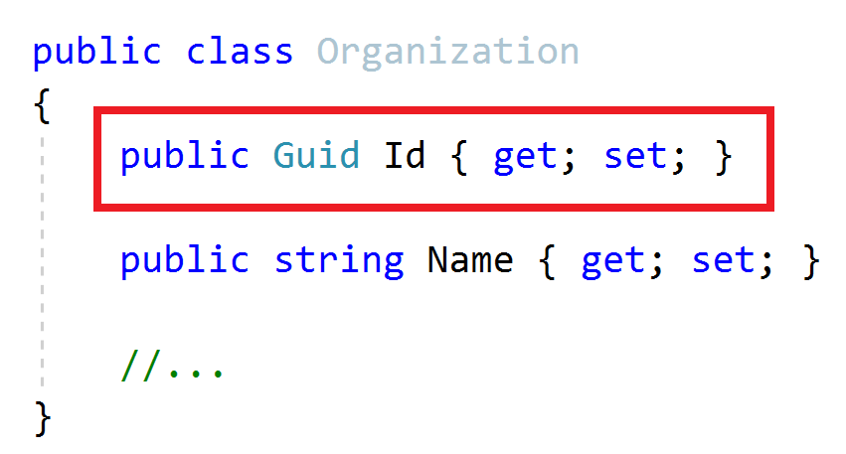
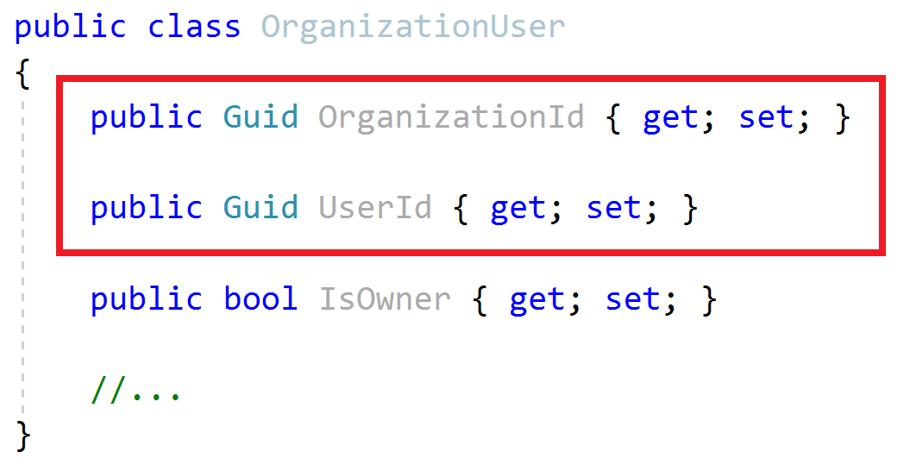
Aggregate Roots / Entities Primary Keys
Aggregate Root
Entity
Define a single Primary Key (Id)
Can define a composite Primary Key
Suggestion: Prefer GUID as the PK

Slide 22
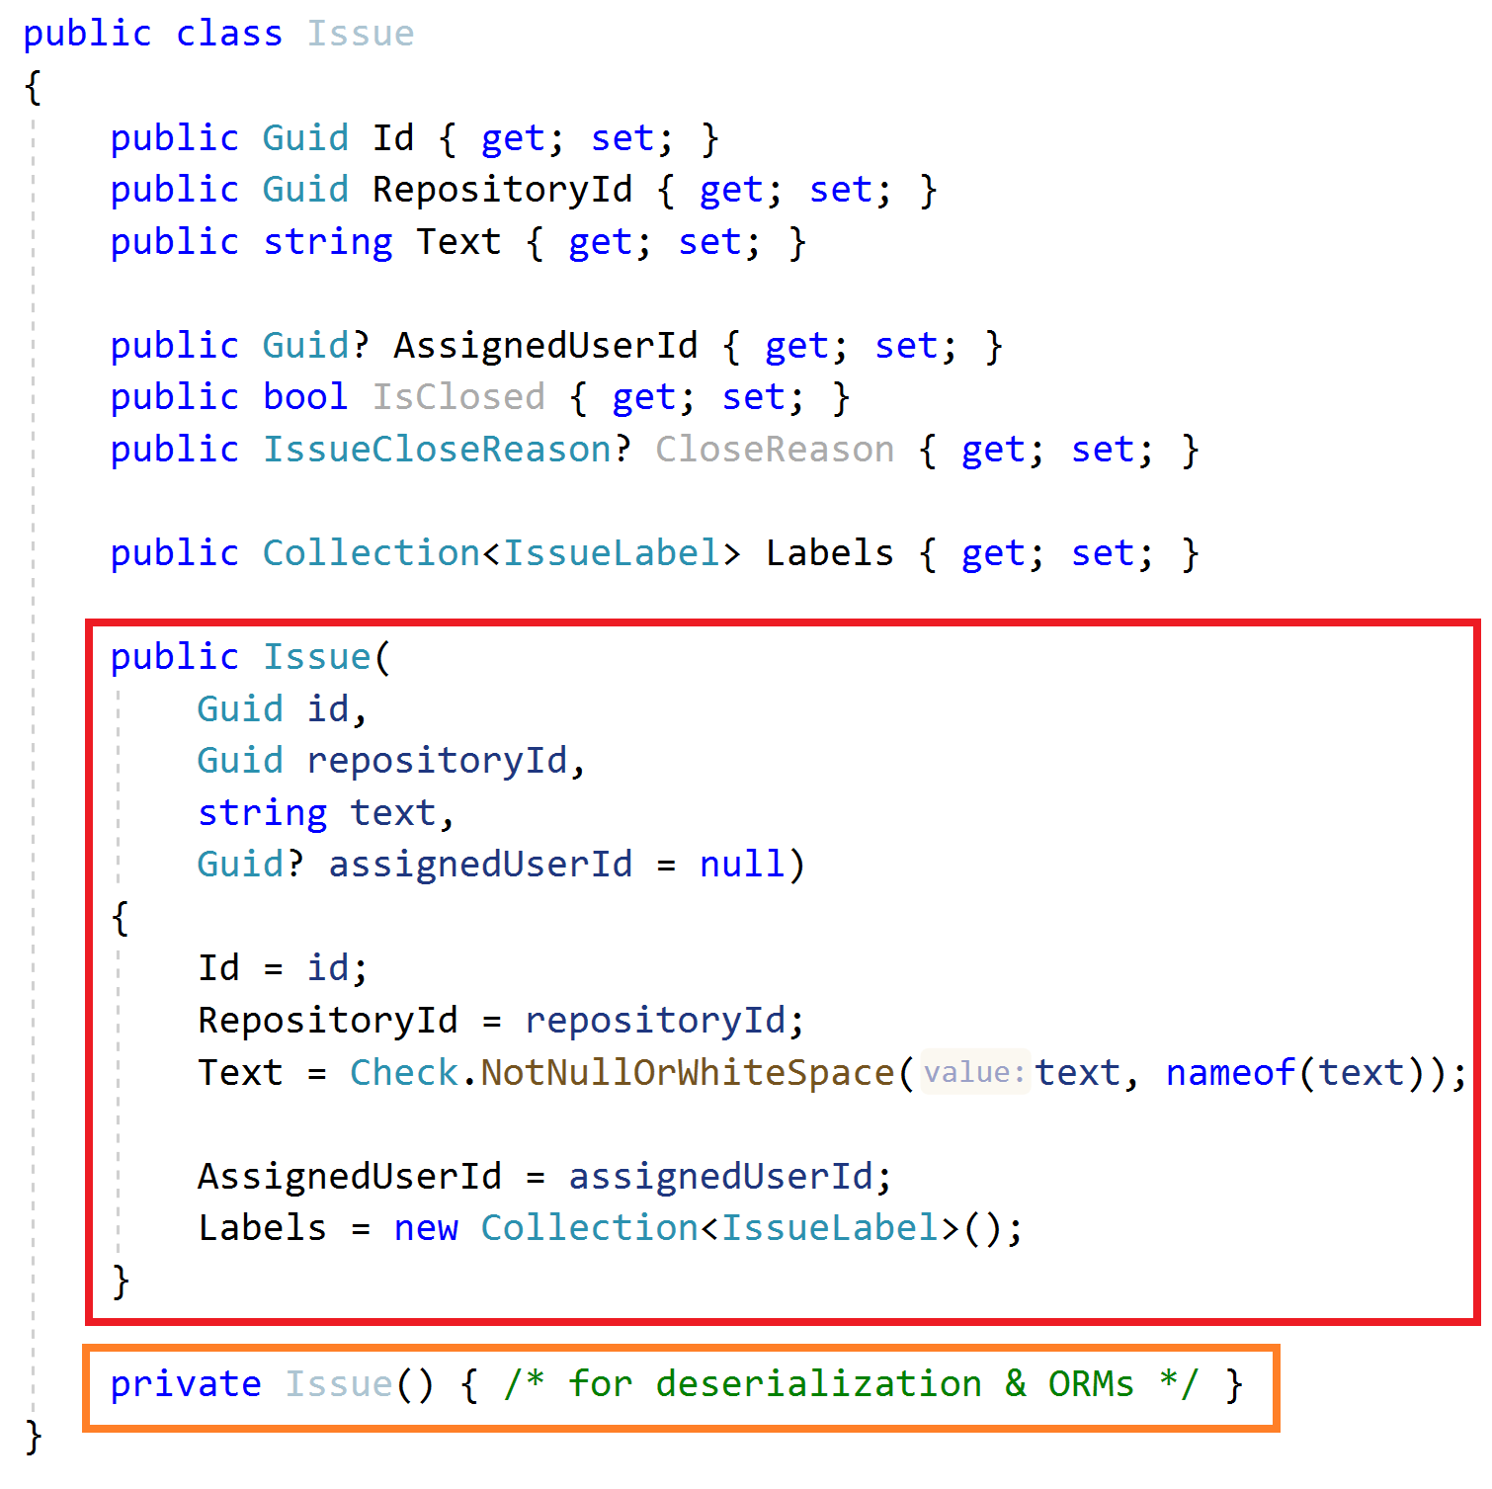
Aggregate Roots & Entities Constructor
Force to create a VALID entity
Get minimum required arguments
Check validity of inputs
Initialize sub collections
Create a private default constructor for ORMs & deserialization
Tip: Get id as an argument, don’t use Guid.NewGuid() inside the constructor
Use a service to create GUIDs

Slide 23
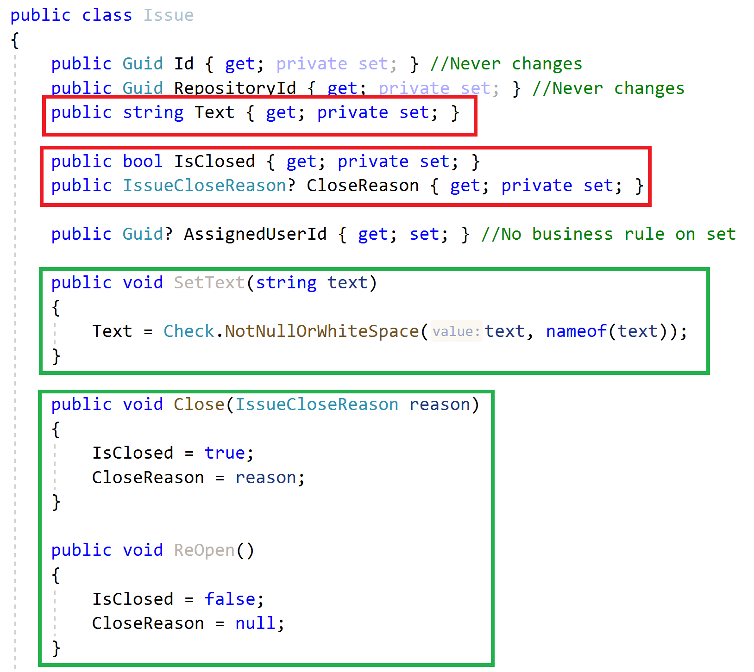
Aggregate Roots & Entities Property Accessors & Methods
Maintain object validity
Use private setters when needed
Change properties via methods

Slide 24
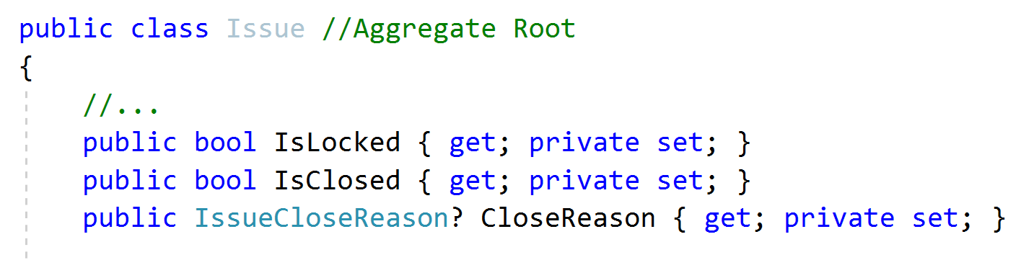
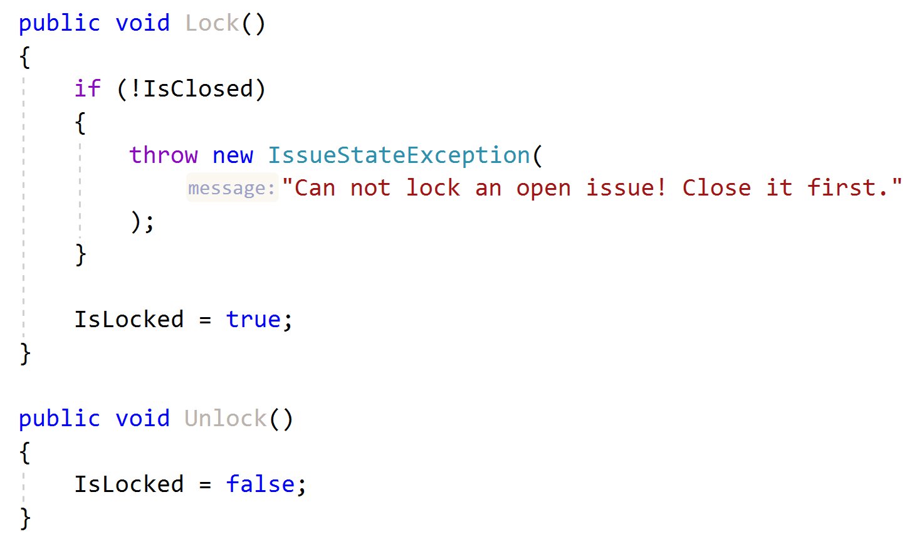
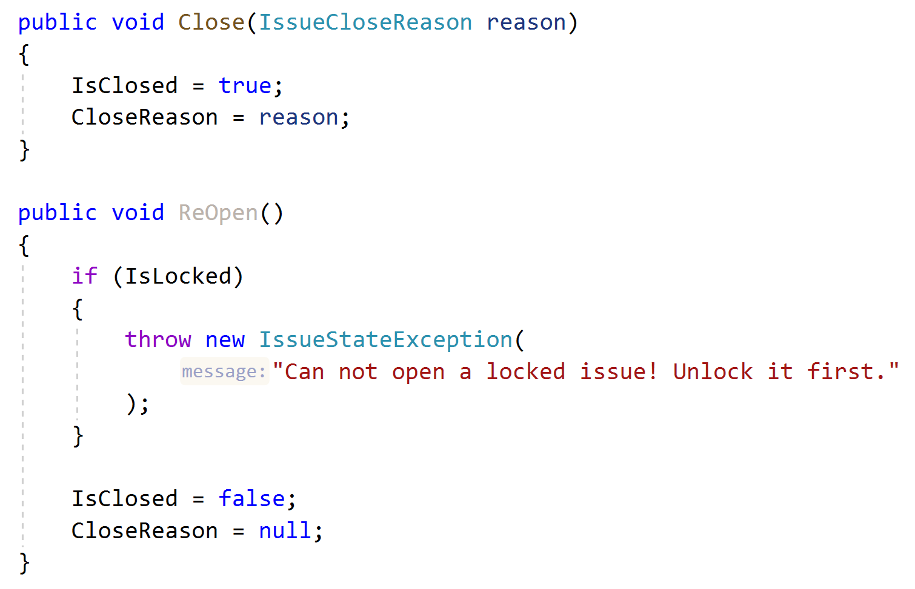
Aggregate Roots & Entities Business Logic & Exceptions
Implement Business Rules
Define and throw specialized exceptions

Slide 25
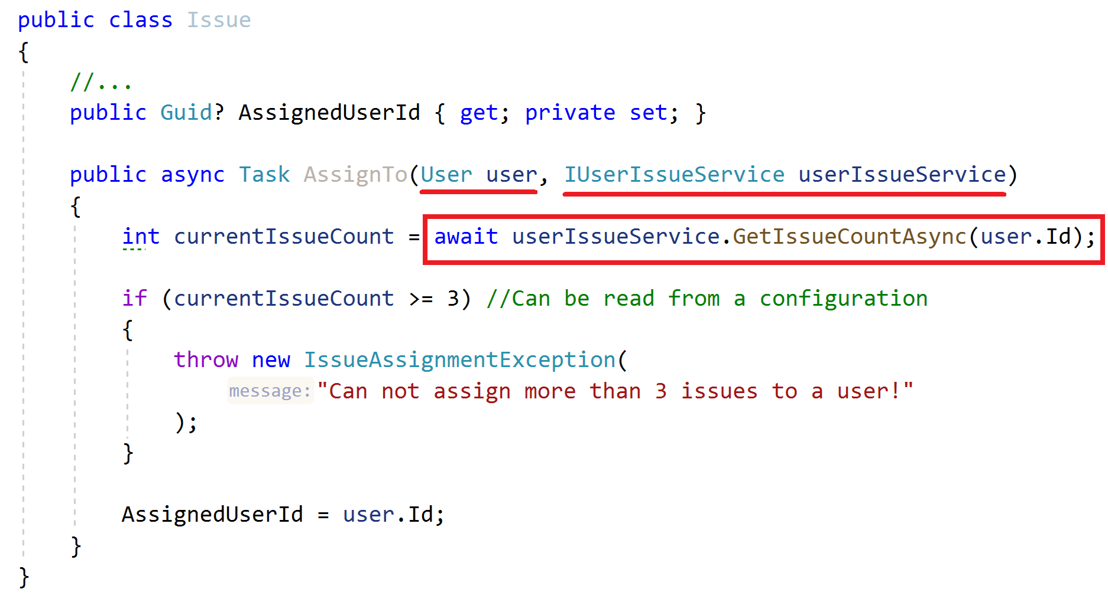
Aggregate Roots & Entities Business Logic Requires External Services
How to implement when you need external services?
Business Rule: Can not assign more than 3 issues to a user!

Slide 26
Aggregate Roots & Entities Business Logic Requires External Services
How to implement when you need external services?
Business Rule: Can not assign more than 3 issues to a user!
ALTERNATIVE..?
Create a Domain Service!

Slide 27
Repositories Principles
A repository is a collection-like interface to interact with the database to read and write entities
Define interface in the domain layer, implement in the infrastructure
Do not include domain logic
Repository interface should be database / ORM independent
Create repositories for aggregate roots, not all entities

Slide 28
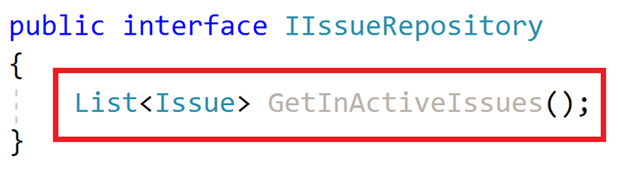
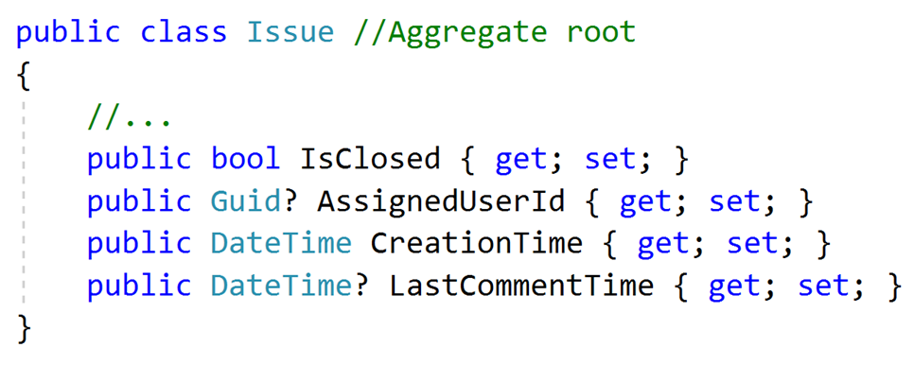
Repositories Do not Include Domain Logic
What is an In-Active issue?

Slide 29
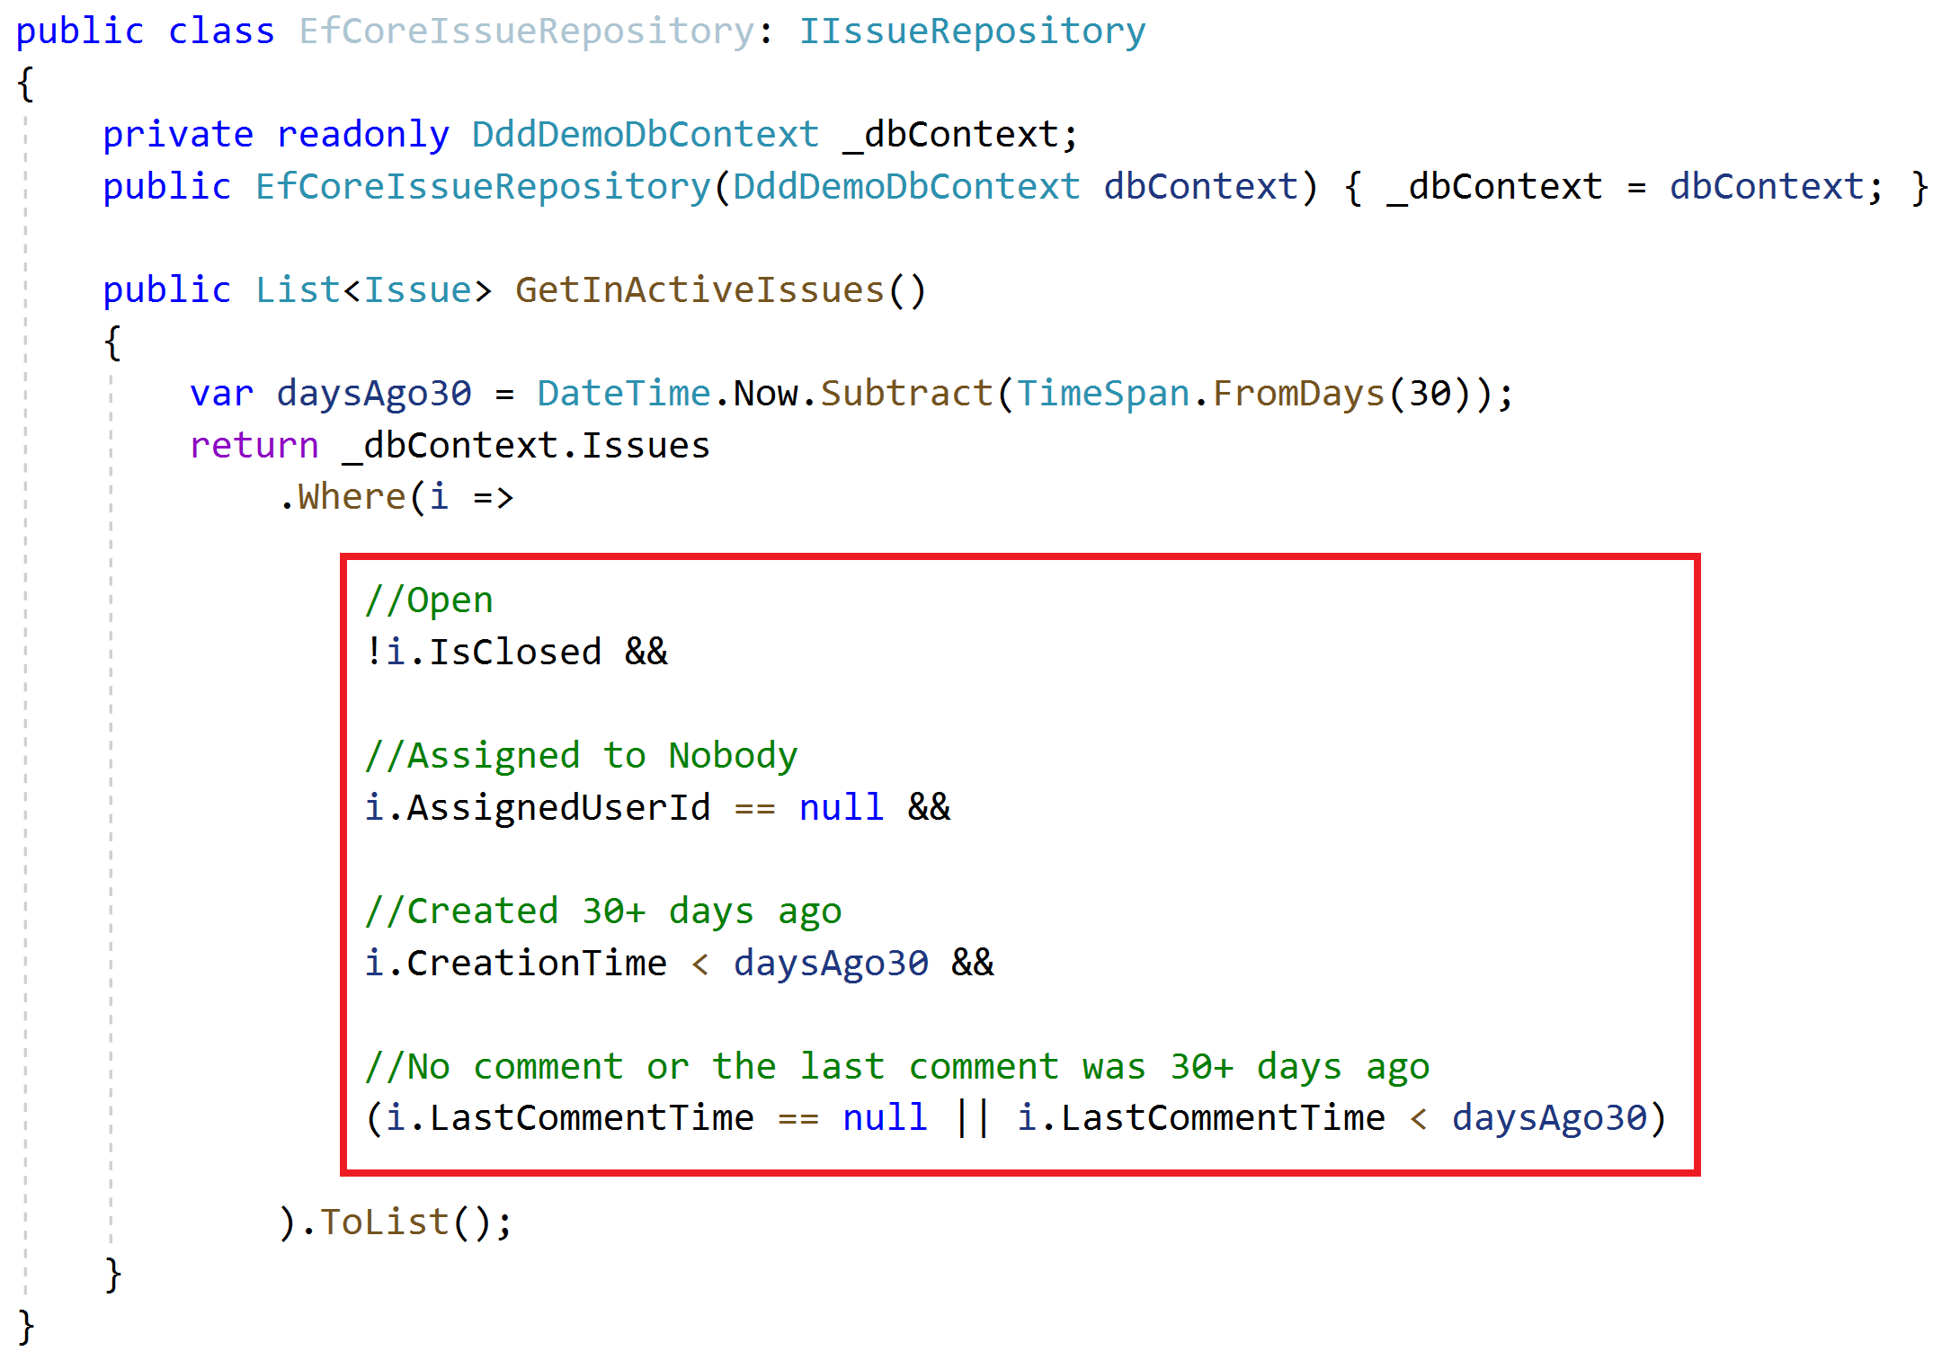
Repositories Do not Include Domain Logic
Implicit definition of a domain rule!
How to re-use this expression?

Slide 30
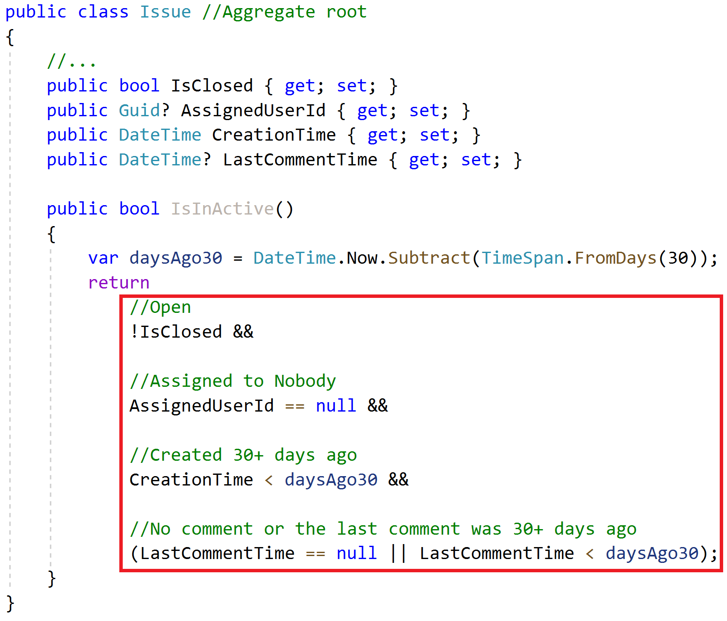
Repositories Do not Include Domain Logic
Implicit definition of a domain rule!
How to re-use this expression?
Copy/paste?
Solution: The Specification Pattern!

Slide 31
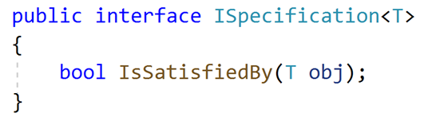
Specifications The Specification Interface
A specification is a named, reusable & combinable class to filter objects.

Slide 32
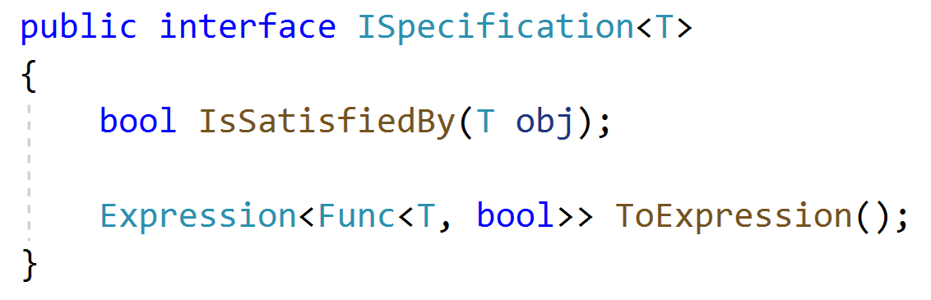
Specifications Extended Specification Interface
A specification is a named, reusable & combinable class to filter objects.

Slide 33
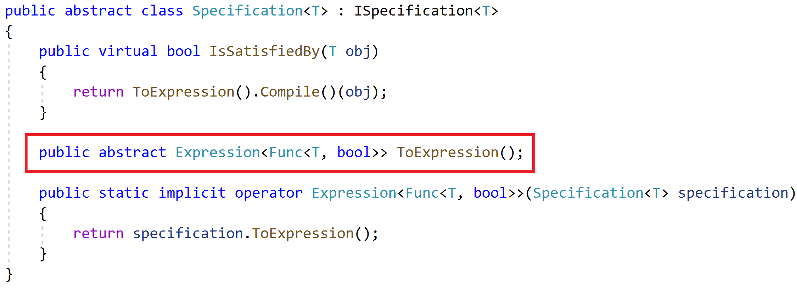
Specifications A Base Specification Class

Slide 34
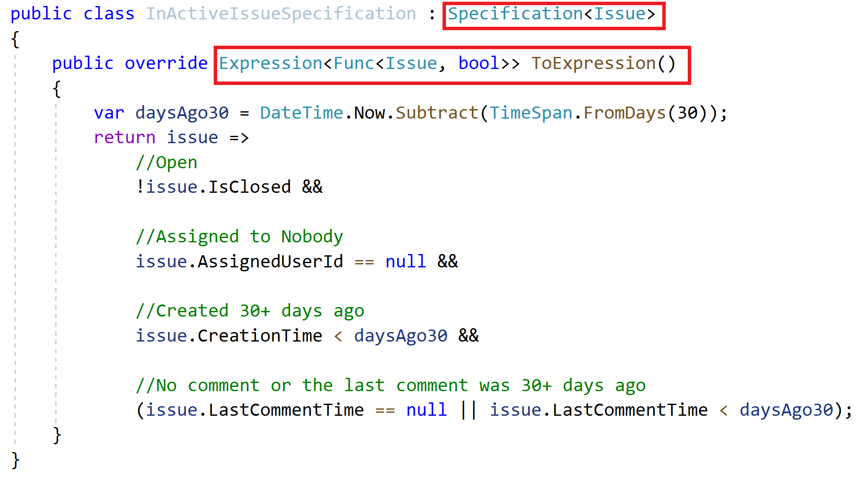
Specifications Define a Specification

Slide 35
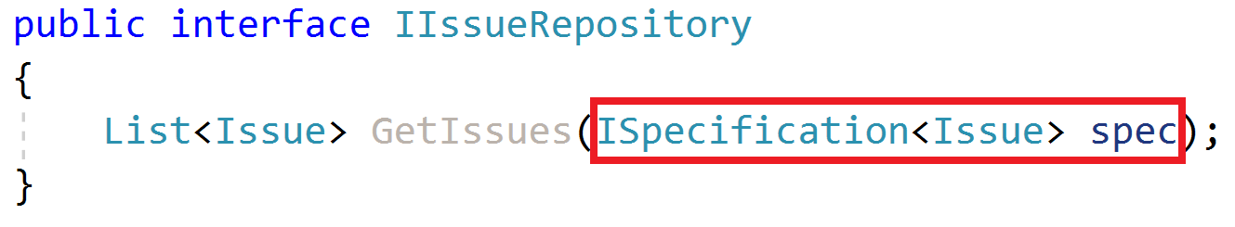
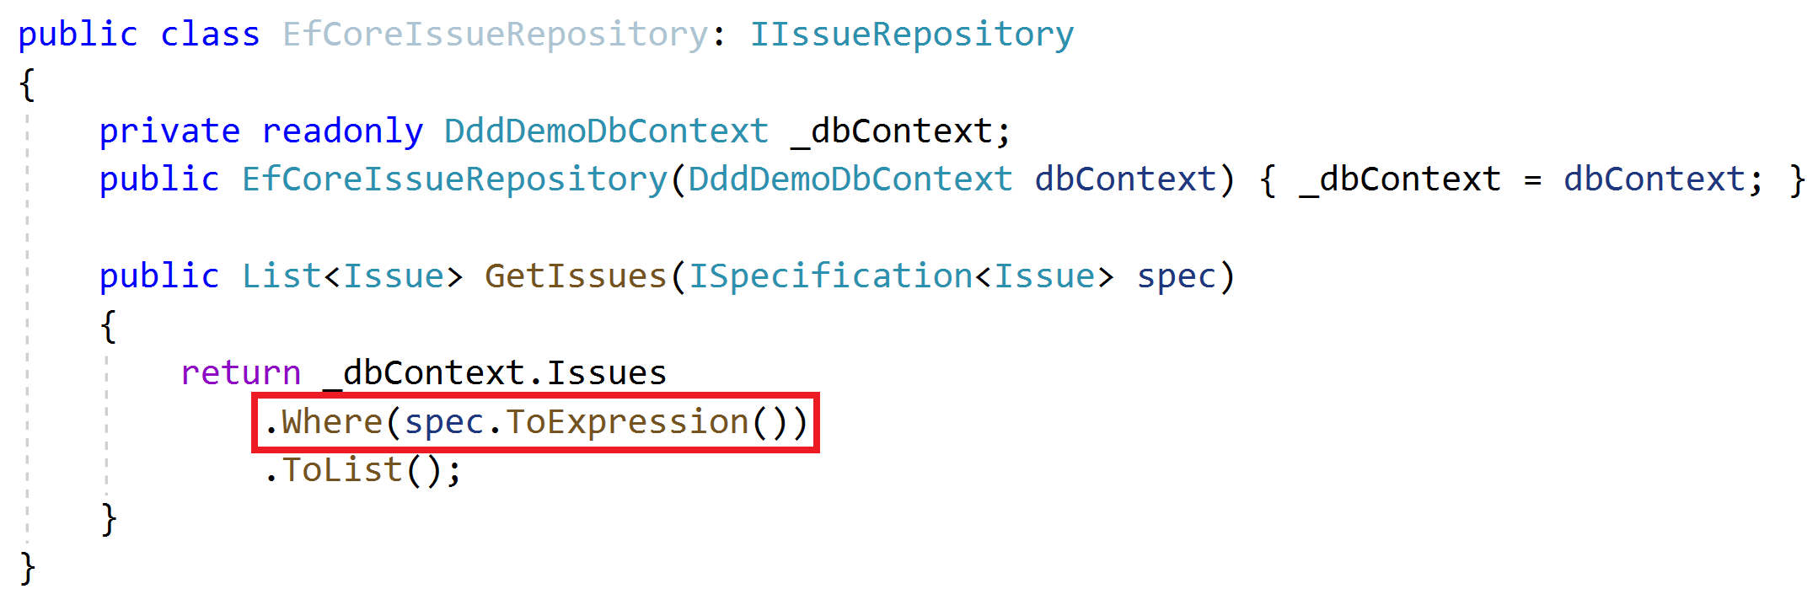
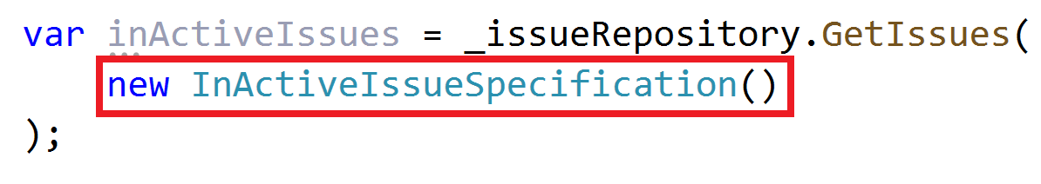
Specifications Use the Specification

Slide 36
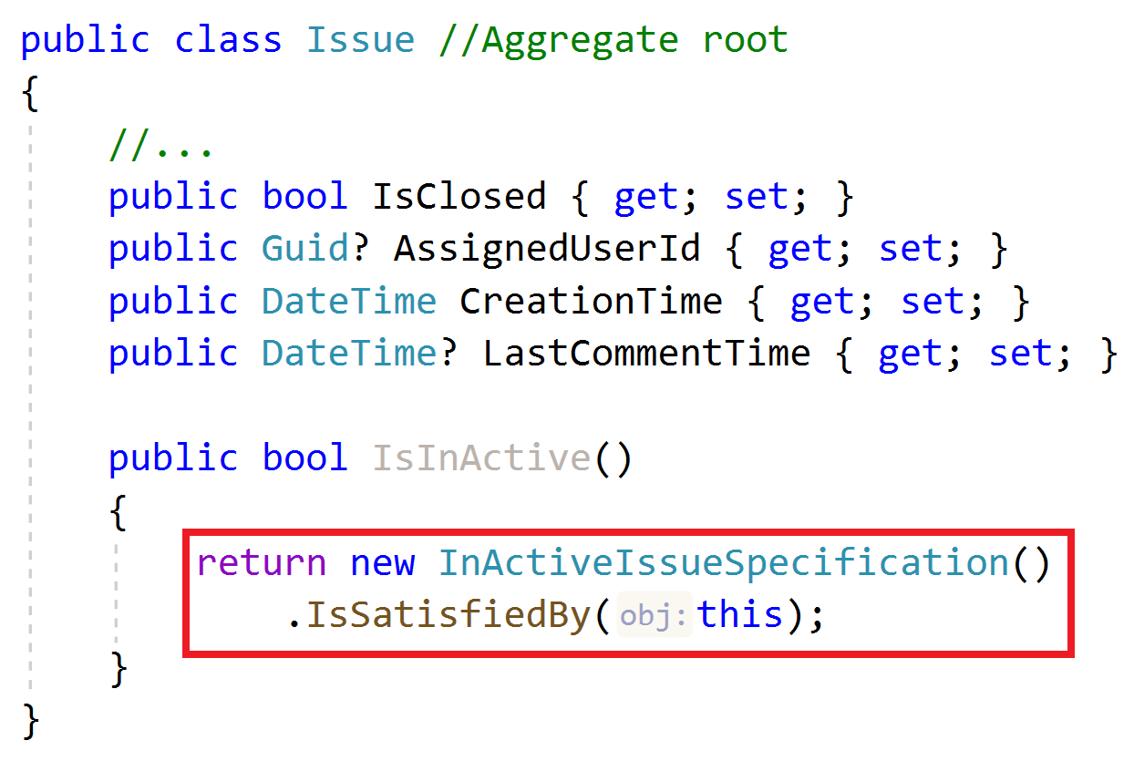
Specifications Use the Specification

Slide 37
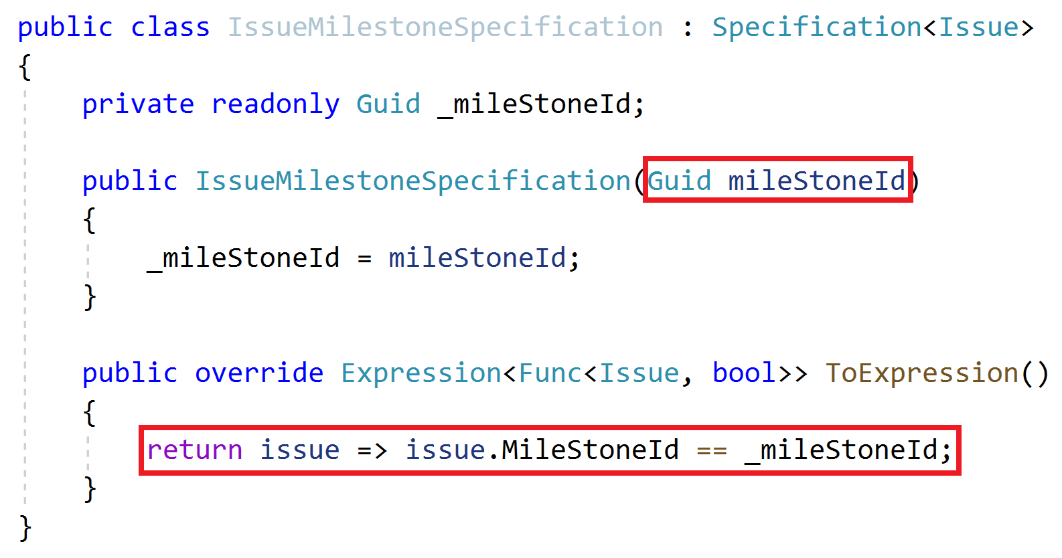
Specifications Parameterized Specifications

Slide 38
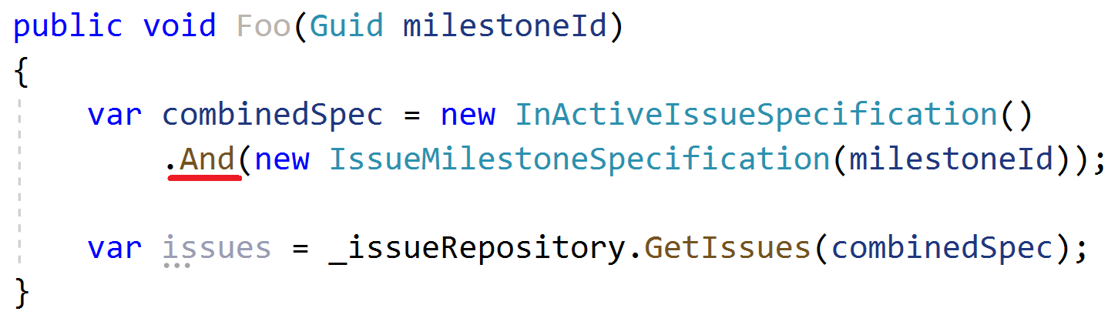
Specifications Combining Multiple Specifications

Slide 39
Domain Services Principles
Implements domain logic that;
Depends on services and repositories
Needs to work with multiple entities / entity types
Works with domain objects, not DTOs

Slide 40
Domain Services Example
Business Rule: Can not assign more than 3 issues to a user

Slide 41
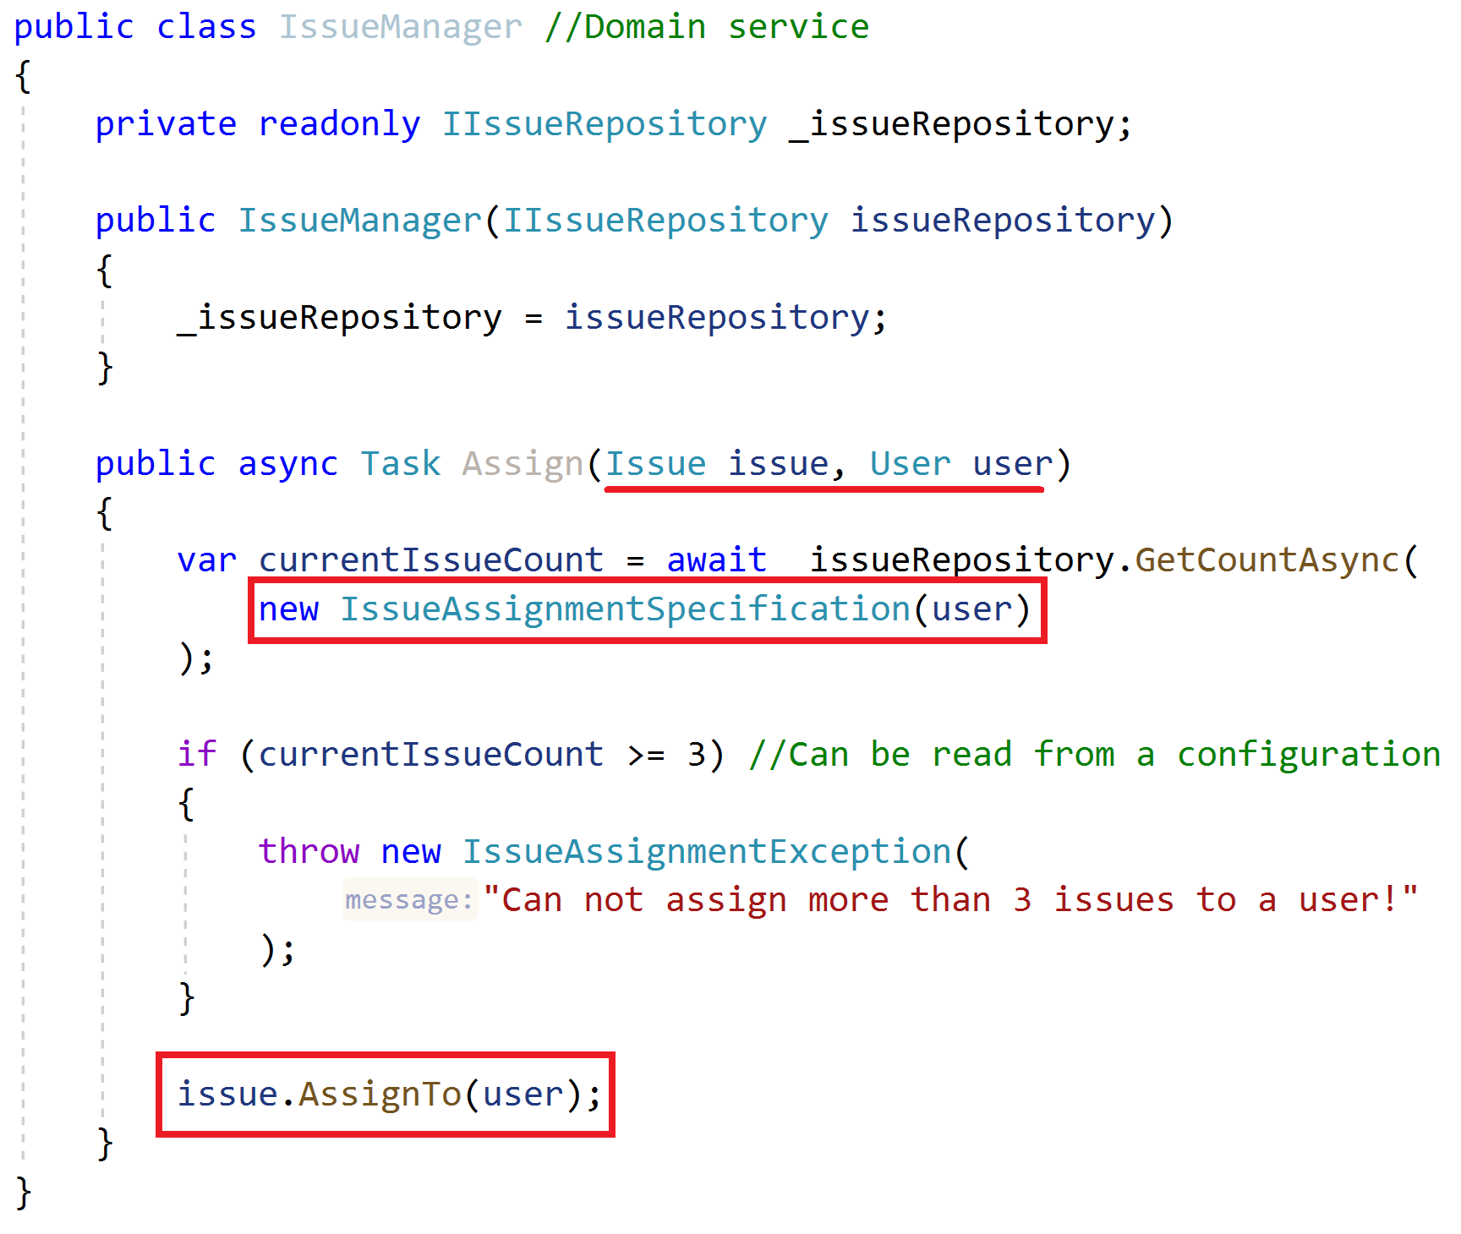
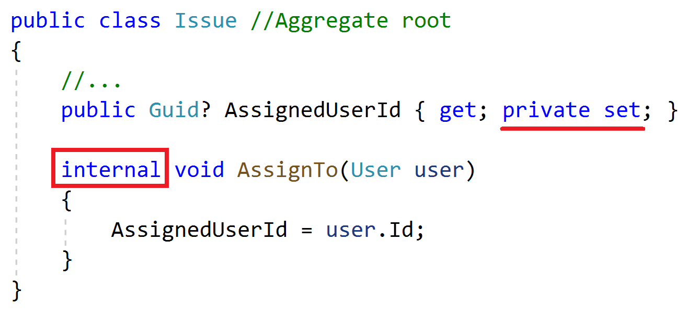
Domain Services Example

Slide 42
Application Services Principles
Implement use cases of the application (application logic)
Do not implement core domain logic
Get & return Data Transfer Objects, not entities
Use domain services, entities, repositories and other domain objects inside

Slide 43
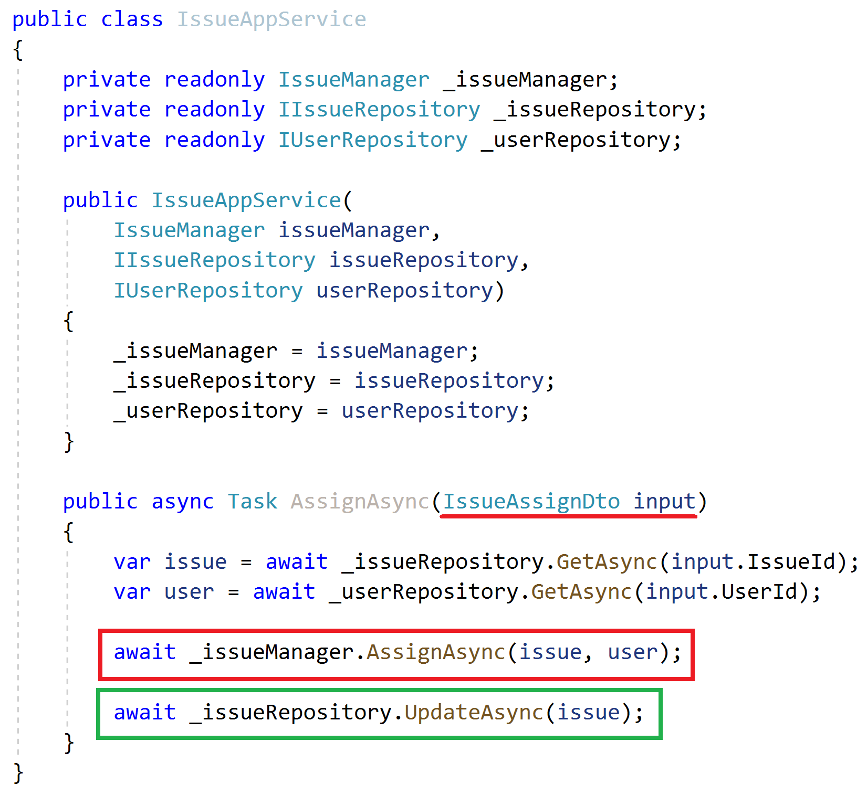
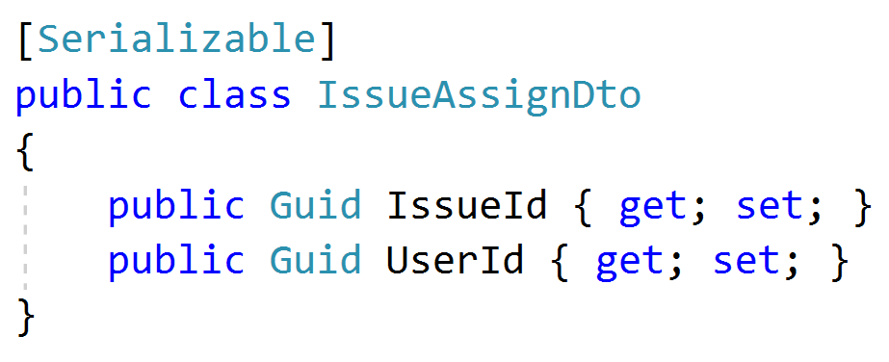
Application Services Example
Inject domain services & repositories
Get DTO as argument
Get aggregate roots from repositories
Use domain service to perform the domain logic
Always update the entity explicitly (don’t assume the change tracking)

Slide 44
Application Services Common DTO Best Practices
Should be serializable
Have a parameterless (default) constructor
Should not contain any business logic
Never inherit from entities! Never reference to entities!

Slide 45
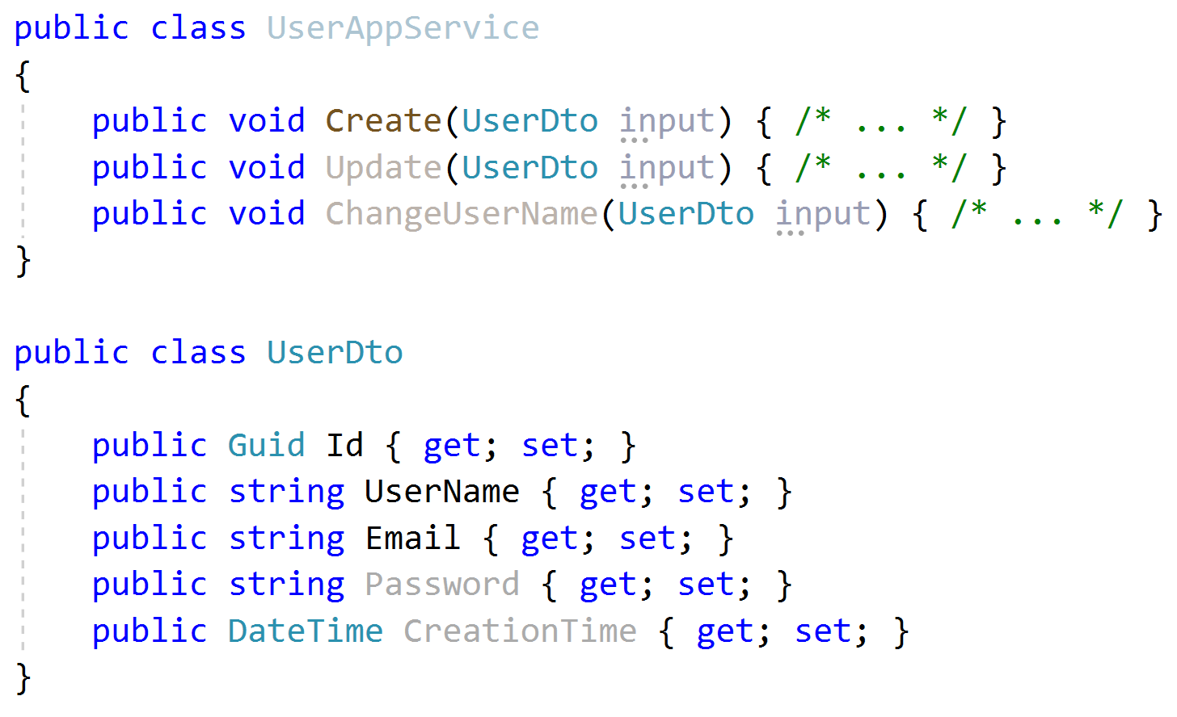
Application Services Input DTO Best Practices
Define only the properties needed for the use case
Do not reuse same input DTO for multiple use cases (service methods)
Id is not used in create! Do not share same DTO for create & update!
Password is not used in Update and ChangeUserName!
CreationTime should not be sent by the client!

Slide 46
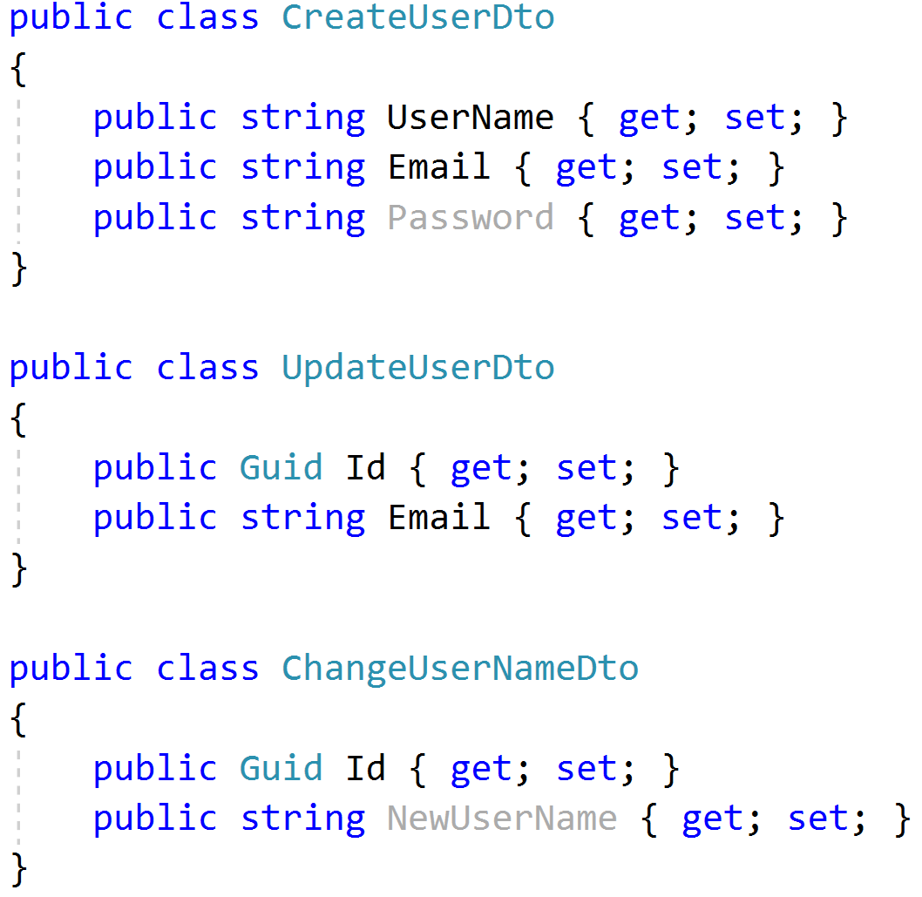
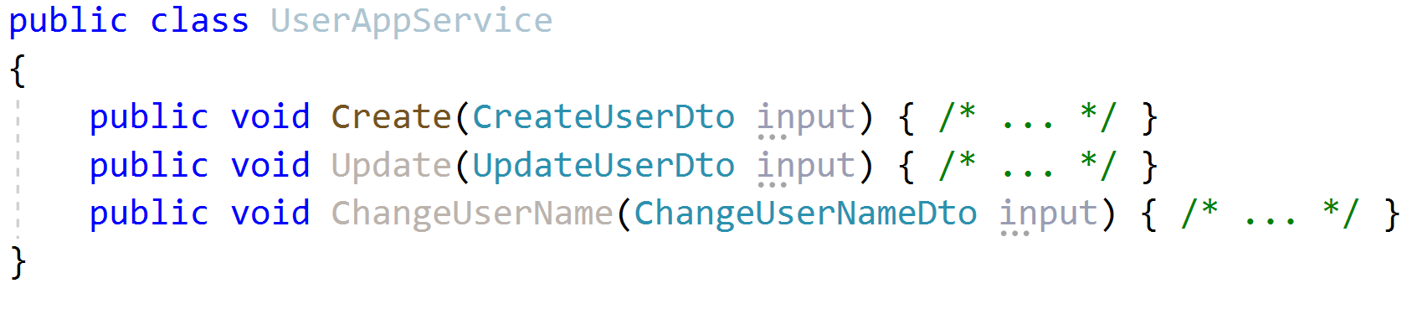
Application Services Input DTO Best Practices
Define only the properties needed for the use case
Do not reuse same input DTO for multiple use cases (service methods)

Slide 47
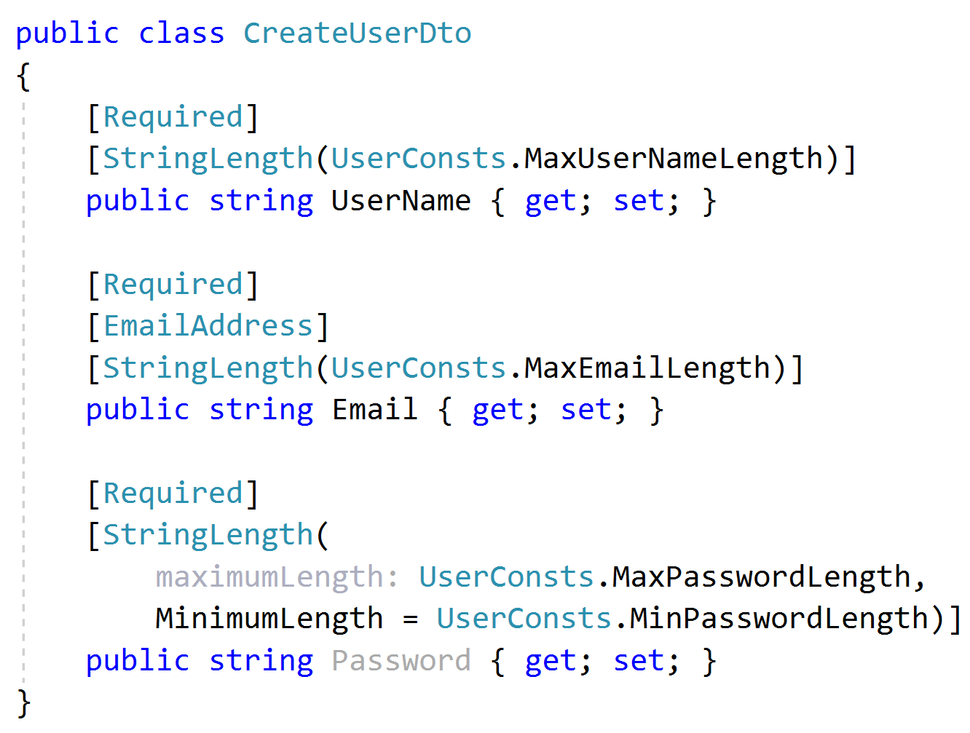
Application Services Input DTO Best Practices
Implement only the formal validation (can use data annotation attributes)
Don’t include domain validation logic (ex: unique username constraint)

Slide 48
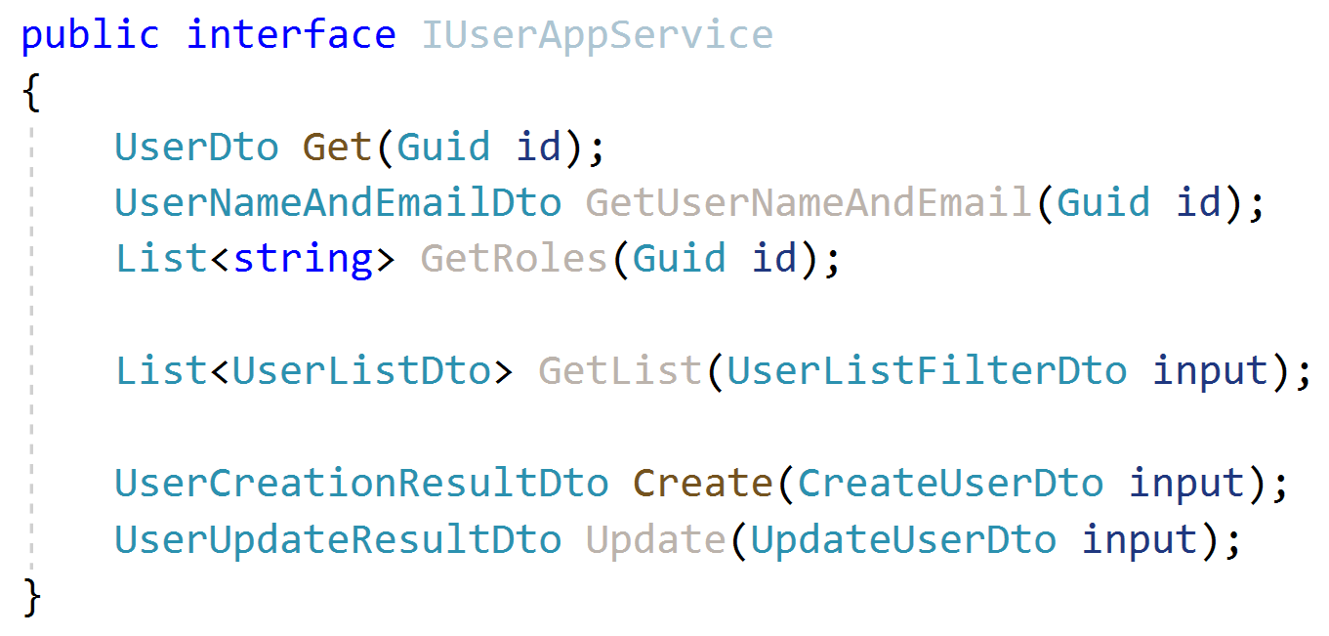
Application Services Output DTO suggestions
Keep output DTO count minimum. Reuse where possible (except input DTOs as output DTO).
Can contain more properties than client needs
Return the entity DTO from Create & update methods.
Exception: Where performance is critical, especially for large result sets.

Slide 49
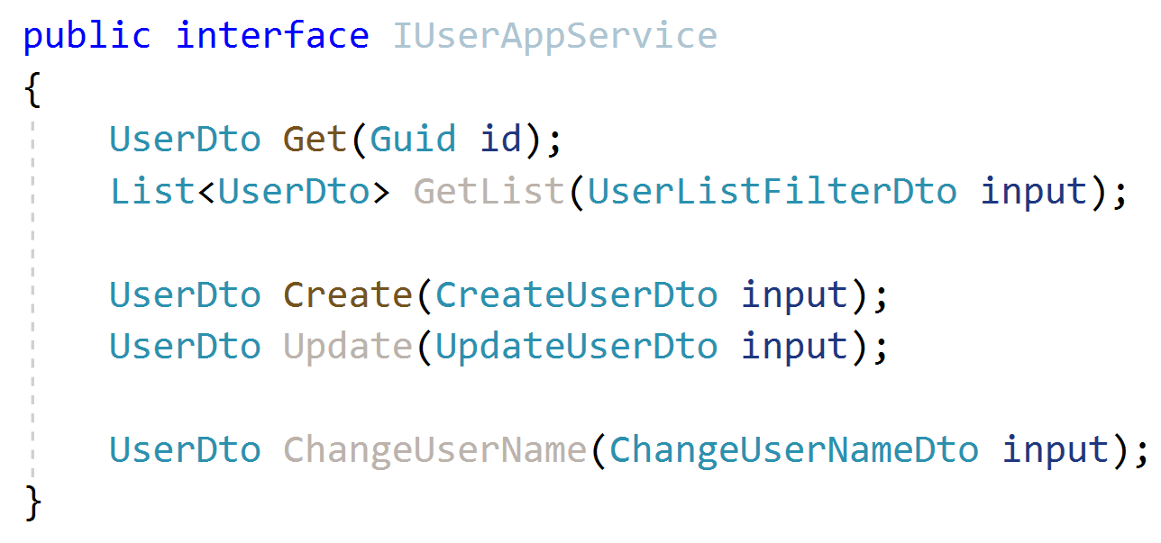
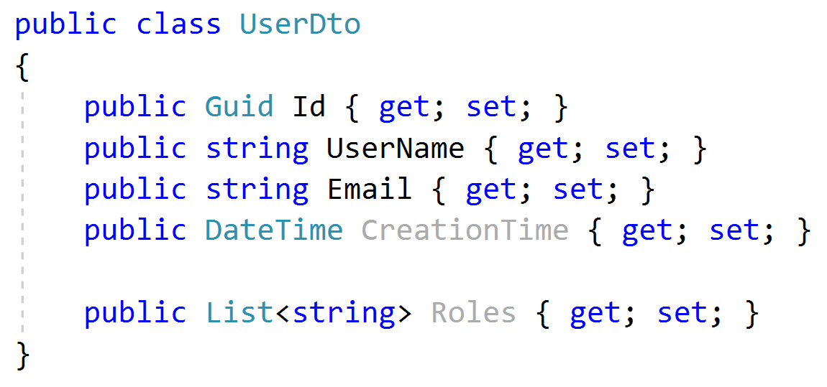
Application Services Output DTO suggestions

Slide 50
Application Services Object to Object Mapping
Use auto object mapping libraries (but, carefully – enable configuration validation)
Do not map input DTOs to entities.
Map entities to output DTOs

Slide 51
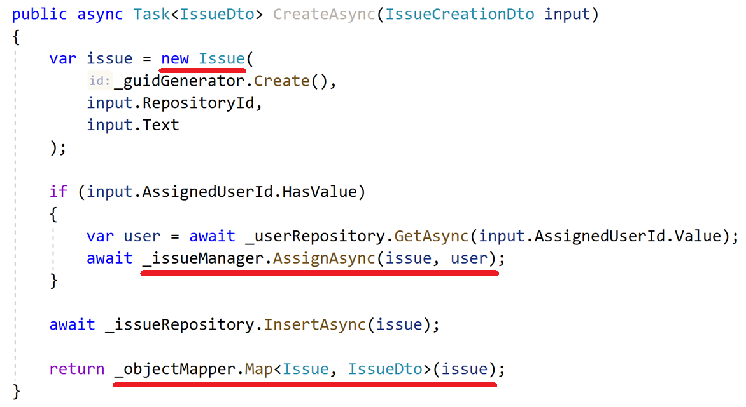
Application Services Example: Entity Creation & DTO Mapping
Don’t use DTO to entity auto-mapping, use the entity constructor.
Perform additional domain actions.
Use repository to insert the entity.
Return DTO using auto-mapping.

Slide 52


Multiple Application Layers
Domain Layer
Back Office Application Layer
Public Web Application Layer
Mobile Application Layer
Create separate application layers for each application type.
Use a single domain layer to share the core domain logic.
REST API
MVC UI
Mobile API
SPA
Browser
Mobile App

Slide 53
Application Logic vs Domain Logic
Business Logic
Examples..?
Application Logic (Use Cases)
Domain Logic

Slide 54
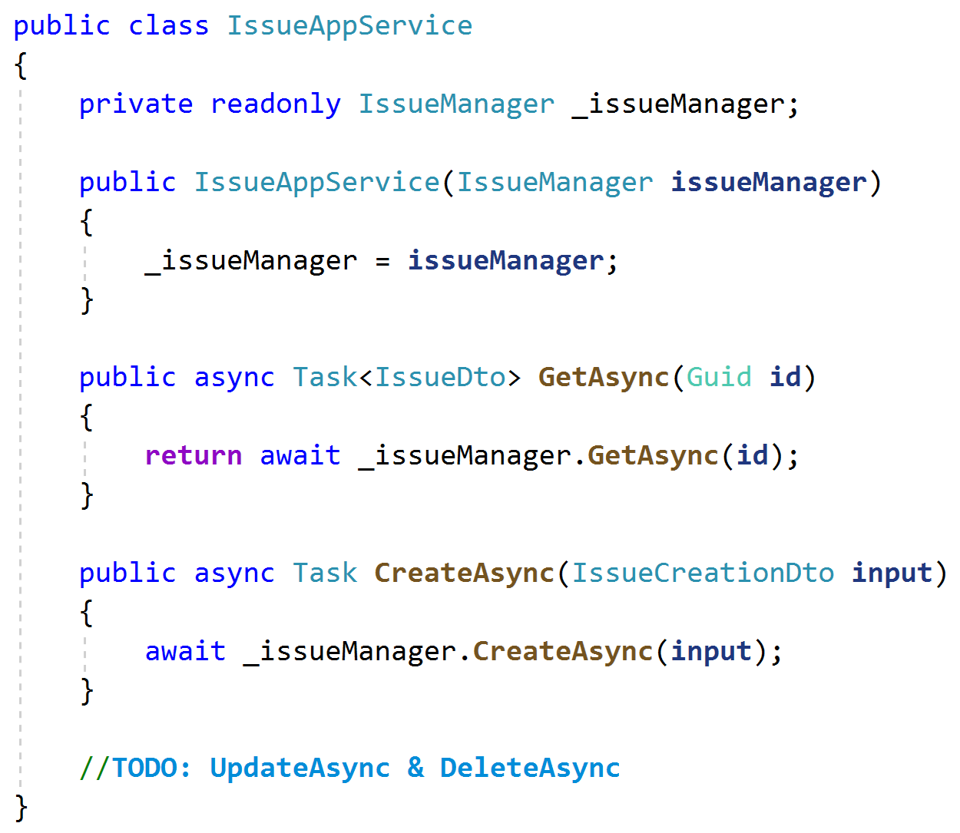
Application Logic vs Domain Logic
Don’t create domain services to perform simple CRUD operations!
Use Repositories in the application services.
Never pass DTOs to or return DTOs from domain services!
DTOs should be in the application layer.

Slide 55
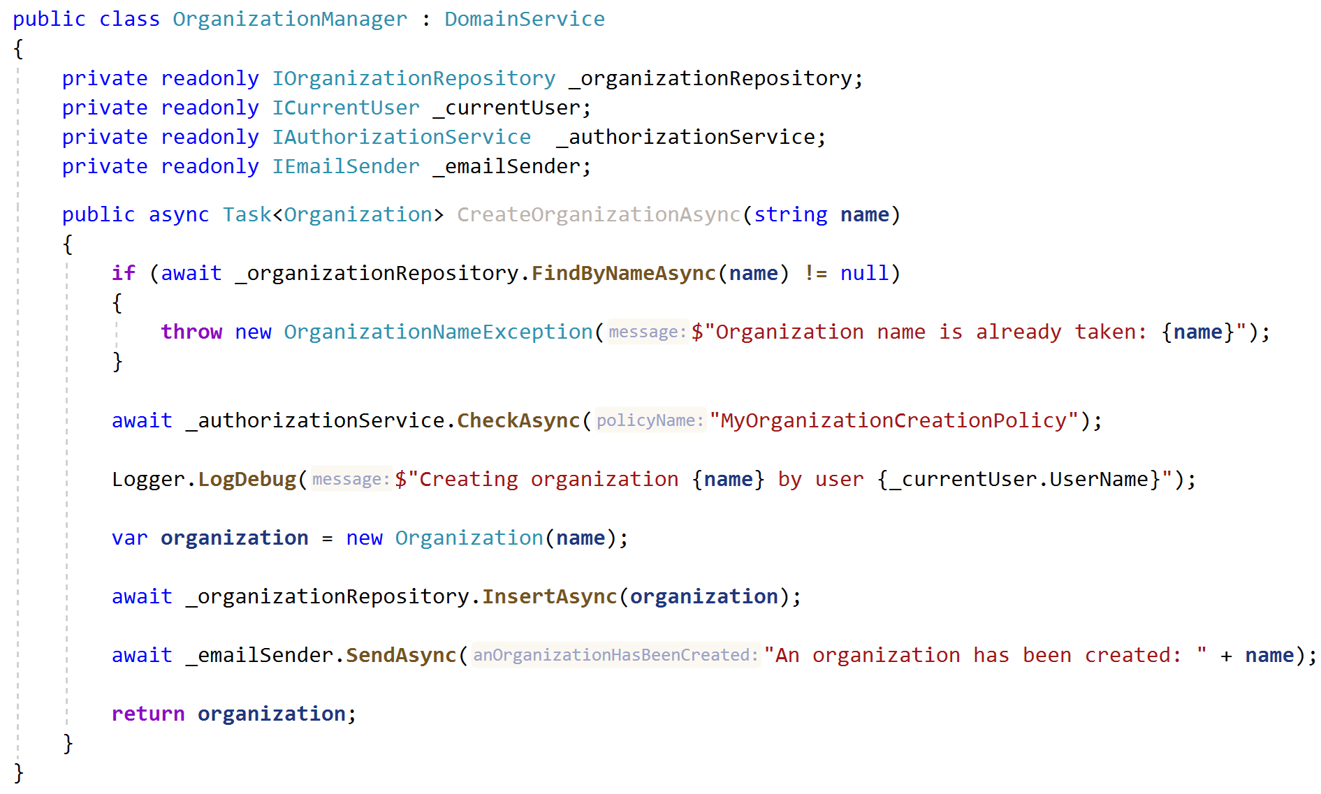
Application Logic vs Domain Logic
Domain service should check duplicate organization name.
Domain service doesn’t perform authorization!
Do in the application layer!
Domain service must not depend on the current user!
Do in the application/UI/API layer!
Domain service must not send email that is not related to the actual business!
Do in the application layer or implement via domain events.

Slide 56
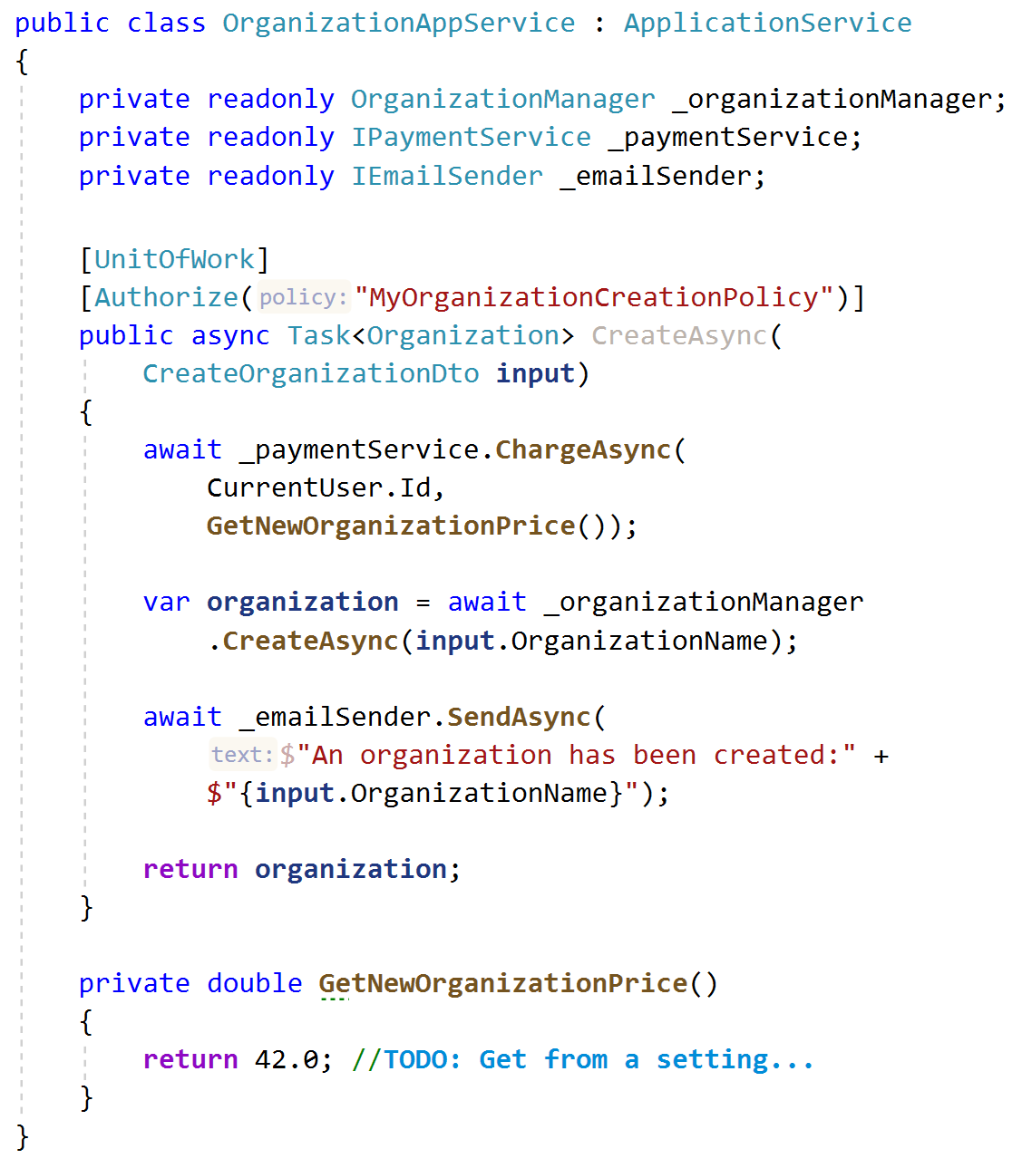
Application Logic vs Domain Logic
Application service methods should be a unit of work (transactional) if contains more than one database operations.
Authorization is done in the application layer.
Payment (infrastructure service) and Organization creation should not be combined in the domain layer. Should be orchestrated by the application layer.
Email sending can be done in the application service.
Do not return entities from application services!
Why not moving payment logic inside the domain service?

Slide 57

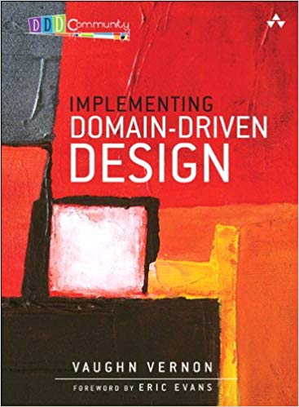
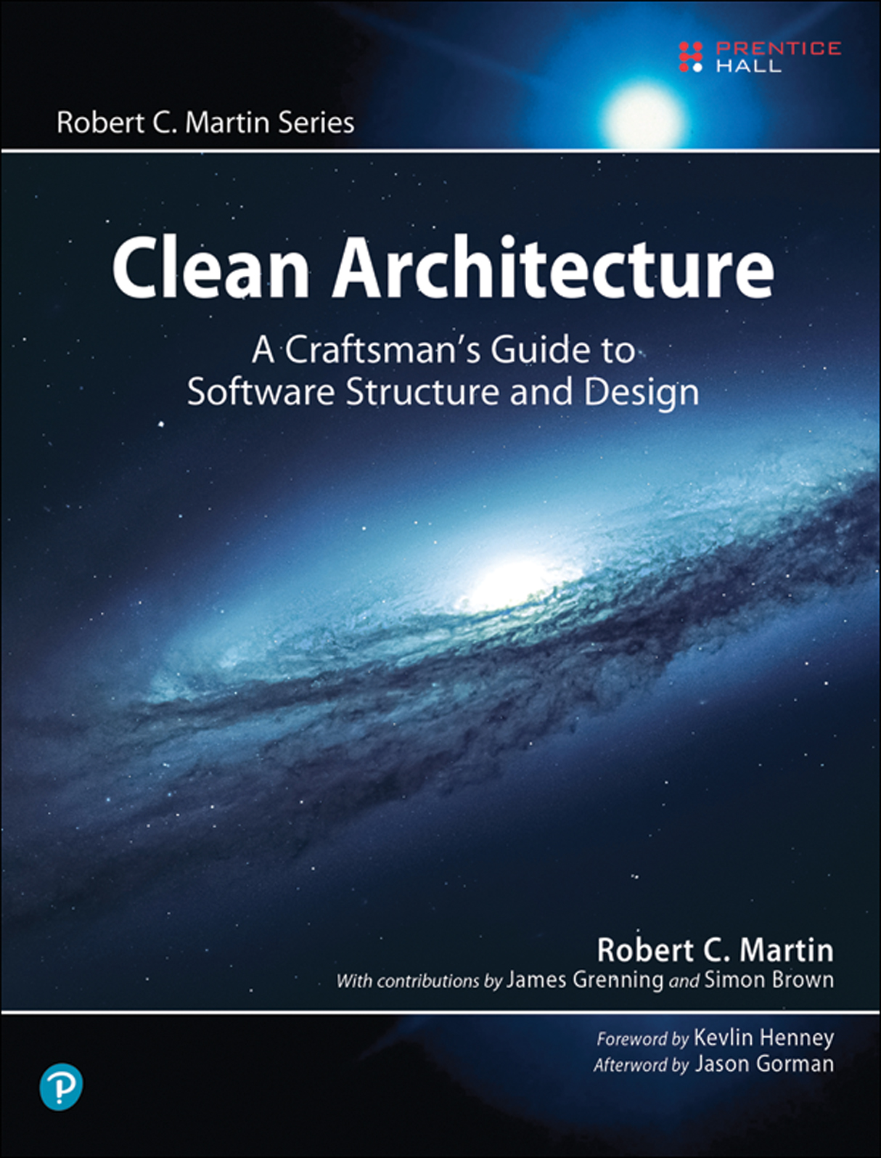
Recommended Books
Domain Driven Design Eric Evans
Implementing Domain Driven Design Vaughn Vernon
Clean Architecture Robert C. Martin

Slide 58
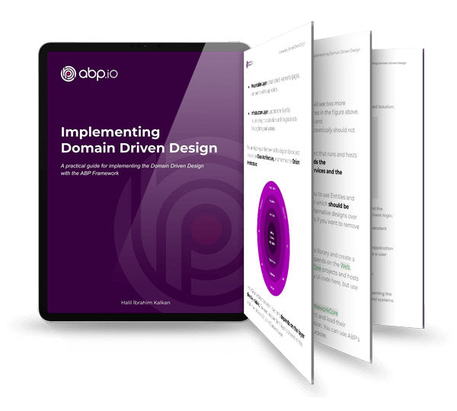
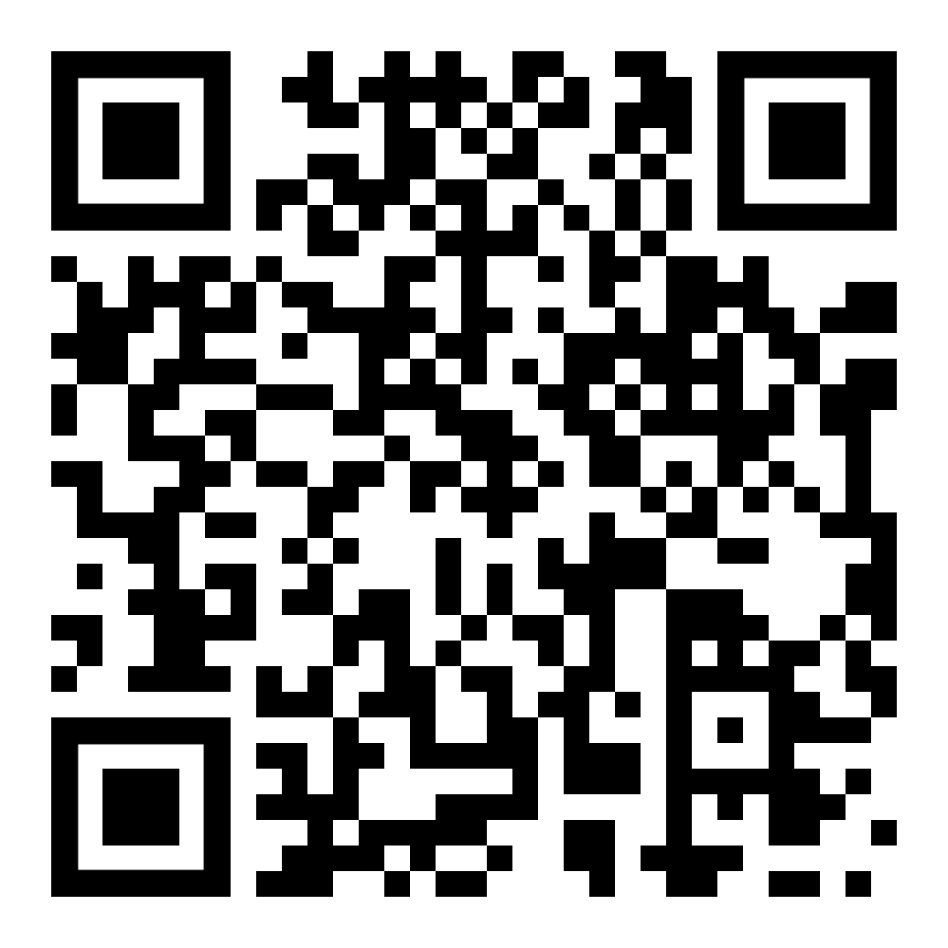
The Reference Book!
DOWNLOAD THE E-BOOK FOR FREE

Slide 59


Slide 60

THANKS FOR
WATCHING
Download the Presentation
Questions..?

